Slide 1
2020 FEVS: Army AcqDemo
Results Analysis
8 July 2021

Slide 2
Outline
Background
Summary Statistics
Employee Engagement
Global Satisfaction
2019 to 2020 Comparisons
Largest 5-year differences
Summary Conclusions

Slide 3
Background
This analysis presents Army AcqDemo 2020 FEVS results
Implementation of 2020 FEVS was markedly different from prior years
  Questions were reduced from 71 “core” items to 37
  New questions were added specifically relating to COVID-19 impacts
  Survey administration was delayed to Fall 2020 vs. Spring
Raw AcqDemo workforce results data were made available via OPM’s “Analysis on Demand” tool
  In prior years component-specific FEVS results data were provided by OPM
To effectively analyze FEVS trends, 2014 – 2019 FEVS data were mapped to the new 2020 question numbering scheme and only items included in 2020 were retained
2020 FEVS questions pertaining to COVID-19 and telework were not analyzed

Slide 4
Army AcqDemo Summary Statistics
2020
Army AcqDemo Response Rate
44%
 | 2020 | 2019 | 2018 | 2017 | 2016 | 2015
Strengths (65%+ Positive Items) | 30 | 27 | 20 | 23 | 16 | 16
Challenges (35%+ Negative Items) | 0 | 1 | 1 | 3 | 5 | 7
3%+
2019 to 2020 Positive:
29
3%+
2019 to 2020 Negative:
0
37 “core” questions common across all FEVS survey years studied.

Slide 5
Employee Engagement

Slide 6
AcqDemo Employee Engagement
The Employee Engagement Index (EEI) is comprised of 15 FEVS questions that the U.S. Office of Personnel Management (OPM) has determined most exemplify “an employee’s sense of purpose that is evident in their display of dedication, persistence, and effort in their work or overall attachment to their organization and its mission” (OPM).
To differentiate EEI from satisfaction, Engagement does not use items that employed a “satisfaction” answer scale
EEI has three components:
  Perceptions of the integrity of leadership, as well as leadership behaviors such as communication and workforce motivation (2020 items 26, 27, 28, 30, and 31)
  Interpersonal relationship between worker and supervisor, including trust, respect, and support (2020 items 21, 22, 23, 24, and 25)
  Employees' feelings of motivation and competency relating to their role in the workplace (20200 items 2, 3, 4, 6, and 7)

Slide 7
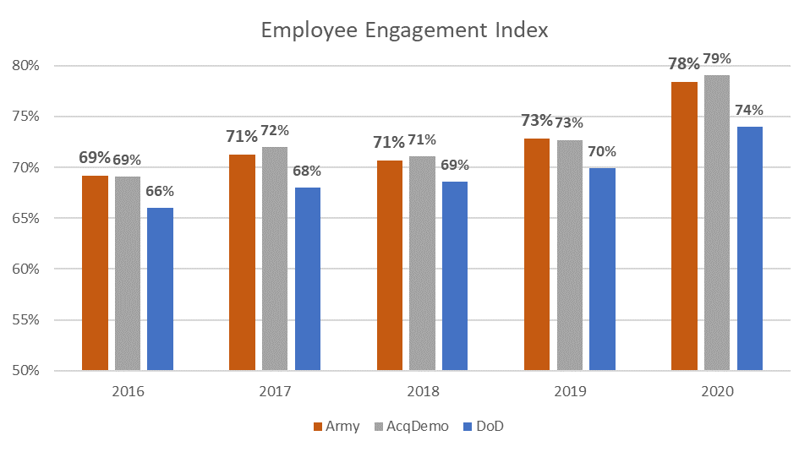
Army vs AcqDemo vs DoD: EEI
DoD is all DoD Survey Participants including those in AcqDemo
AcqDemo is all AcqDemo Survey Participants including those in Army
Army includes only Army AcqDemo employees

Slide 8
Global Satisfaction

Slide 9
AcqDemo Global Satisfaction
The FEVS Global Satisfaction Index (GSI) is an average of four distinct satisfaction areas assessed in the survey, resulting in a single indicator measure defined by OPM.
GSI includes:
  Job Satisfaction: Considering everything, how satisfied are you with your job? (2020 Q. 36)
  Pay Satisfaction: Considering everything, how satisfied are you with your pay? (2020 Q. 37)
  Organizational Satisfaction: Considering everything, how satisfied are you with your organization? (2020 Q. 38)
  Recommend Organization: I recommend my organization as a good place to work. (2020 Q. 17)

Slide 10
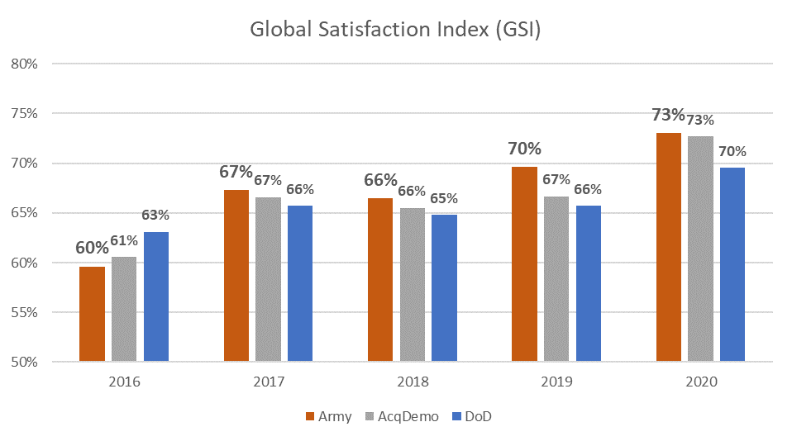
Army vs AcqDemo vs DoD: GSI
DoD is all DoD Survey Participants including those in AcqDemo
AcqDemo is all AcqDemo Survey Participants including those in Army
Army includes only Army AcqDemo employees

Slide 11
2019 to 2020 Comparisons

Slide 12
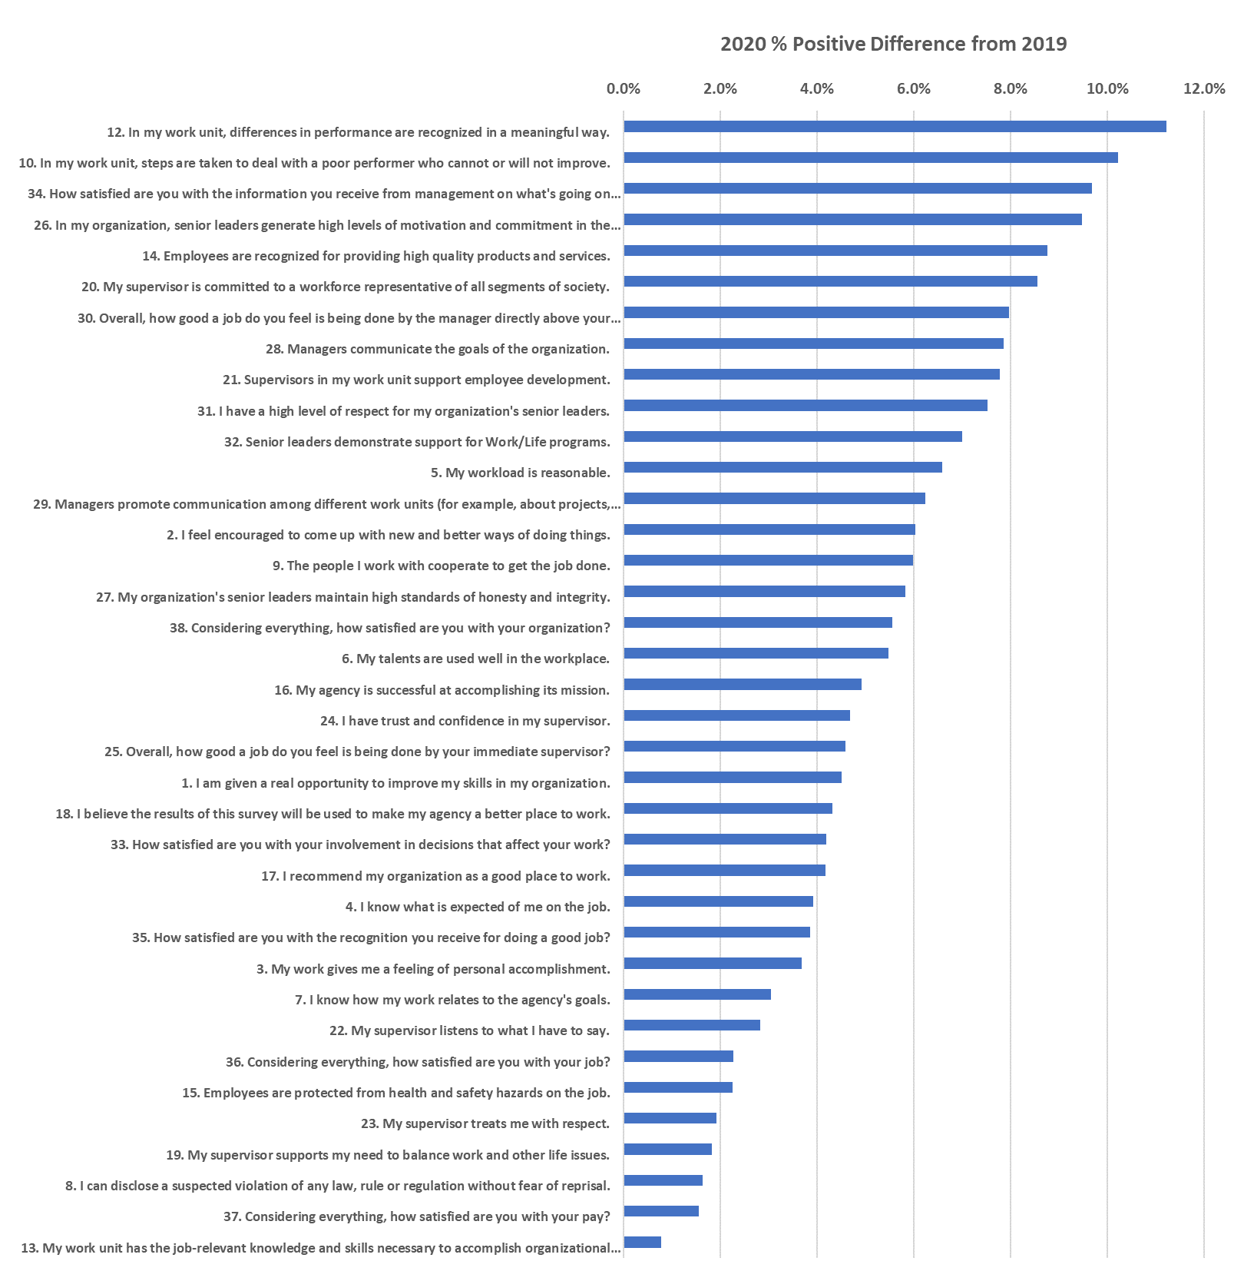
Army AcqDemo Shift in Positive Responses,
2020 vs. 2019
(most improvement)
All 2020 positive responses improved at least 1% from 2019
(least improvement)
Greater positive numbers indicate largest 2019 – 2020 improvement

Slide 13
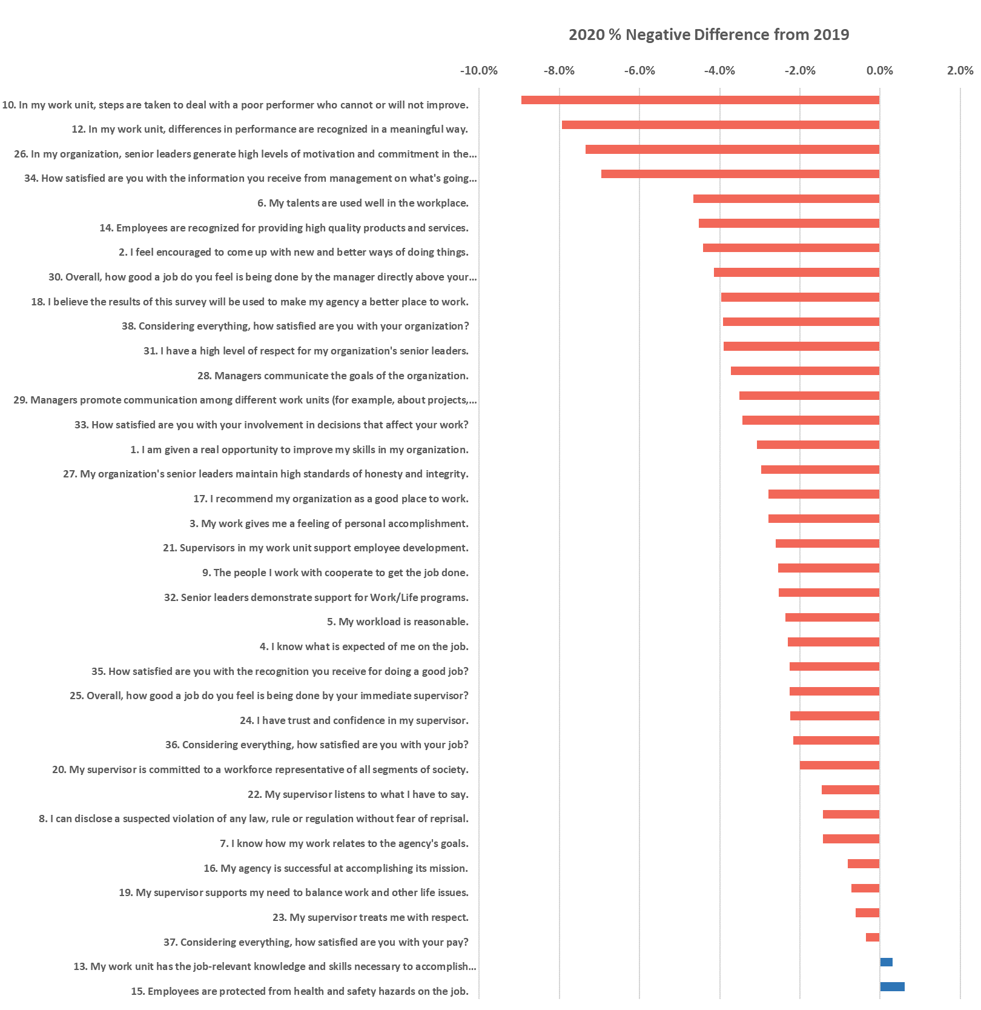
Army AcqDemo Shift in Negative Responses,
2020 vs. 2019
(most improvement)
All but two 2020 negative responses improved from 2019
Greater negative numbers indicate largest 2019 – 2020 improvement
(least improvement)

Slide 14
Top 2020 Army AcqDemo Positive
& Negative Items
Positives
All 2020 negative responses improved at least 0.5% from 2019
Negatives

Slide 15
Largest 5-Year Differences

Slide 16
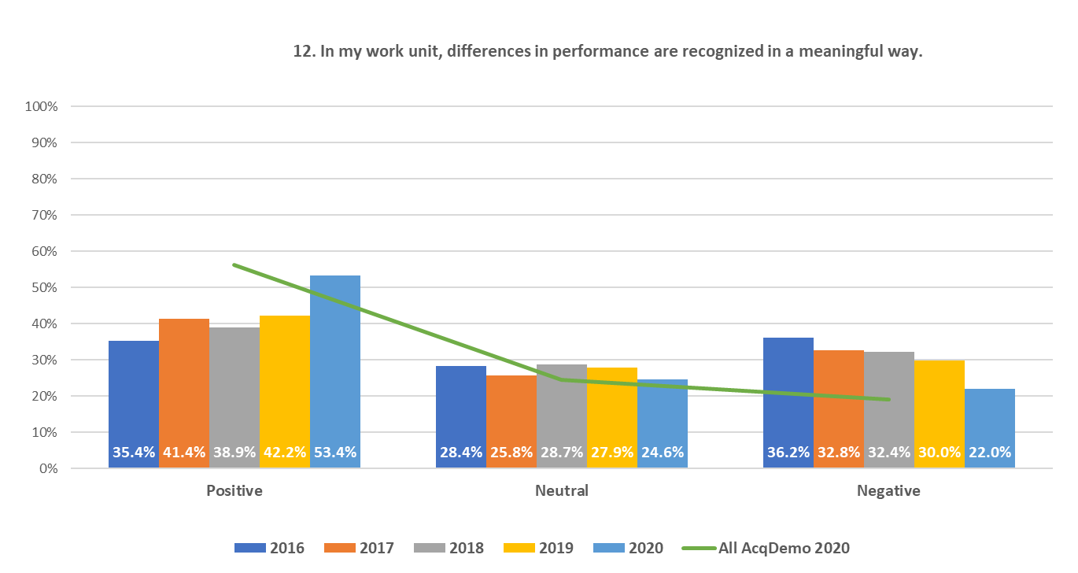
Army AcqDemo FEVS Largest
Positive 5-Year Net Change
+18% 2016 to 2020

Slide 17
Top 5 Items 5-Year Army AcqDemo
Net Positive Change
Opinions on recognition of performance improved the most over the last 5 years – may suggest a greater understanding of CCAS philosophy
Satisfaction with organization also improved

Slide 18
Summary Conclusions

Slide 19
Summary Conclusions
2020 FEVS administration was significantly different from prior years
  Questions were reduced from 71 “core” items to 37
  New questions were added specifically relating to COVID-19 impacts
  Survey administration was delayed to Fall 2020 vs. Spring
2020 AcqDemo FEVS responses were materially more positive than 2019
  Nearly all core questions saw positive responses improve by 3%+; none were more negative
  AcqDemo FEVS participation increased in 2020
  Similar increase in positive responses was observed across all DoD and Federal workforce
AcqDemo Satisfaction and Engagement Indices were notably higher than DoD and overall Federal workforce
While the increased positive responses are welcome, additional research is needed to better understand the root of the comprehensive positive shift
  Will 2021 AcqDemo survey produce similar results?
  Will 2021 FEVS results show sustained opinions?

Slide 20
Backup
Item-Level Results Analysis

Slide 21
Army AcqDemo FEVS: 2020

Slide 22
Army AcqDemo FEVS: 2020

Slide 23
Army AcqDemo FEVS: 2020

Slide 24
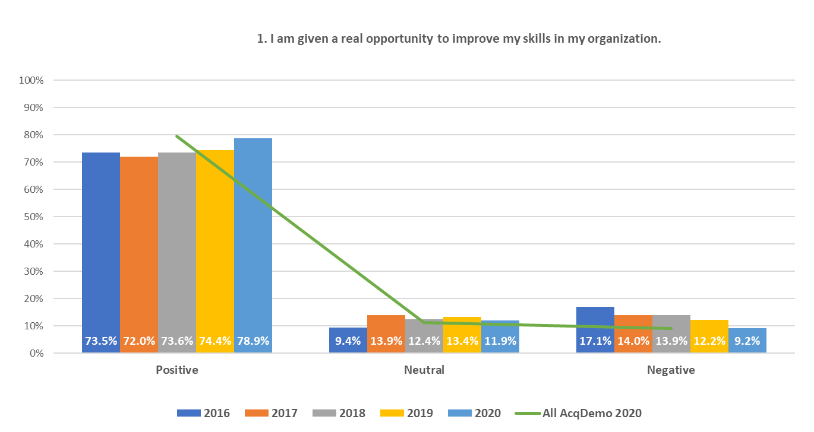
2020 FEVS Item-Level Results Analysis: Army AcqDemo
24

Slide 25
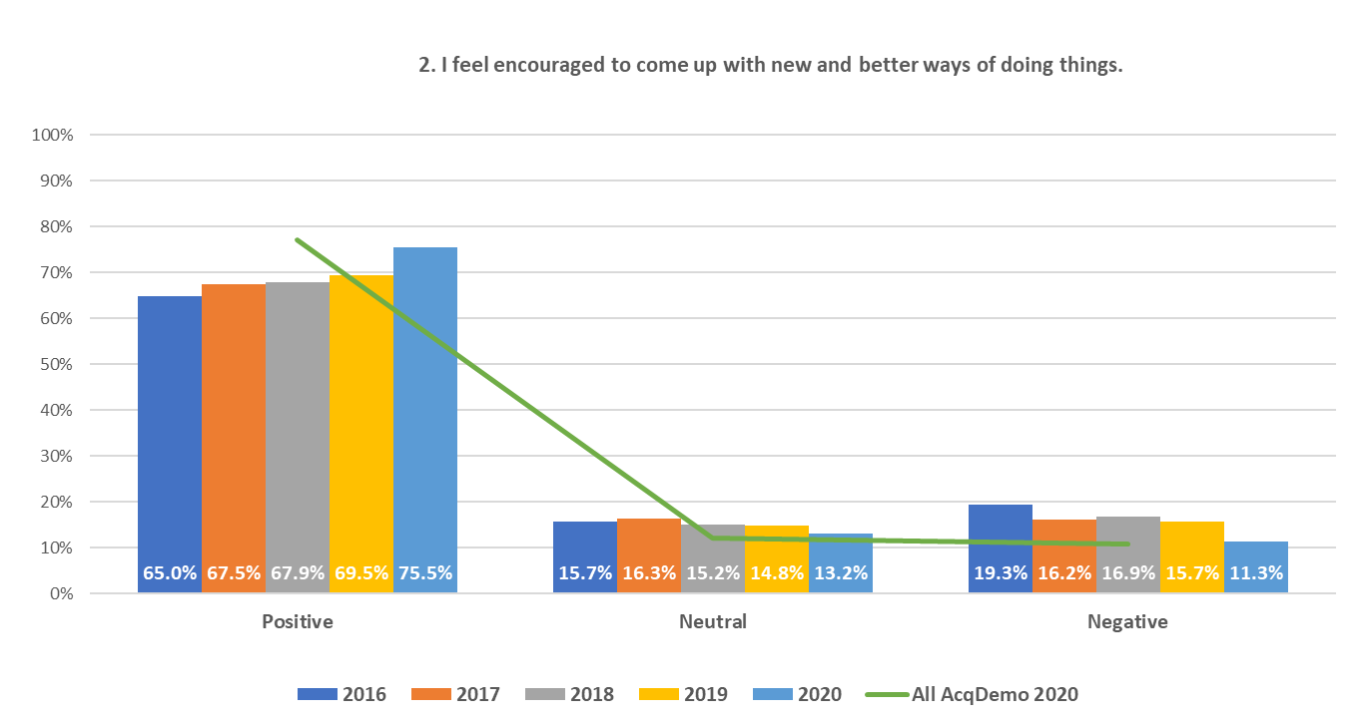
2020 FEVS Item-Level Results Analysis: Army AcqDemo
25

Slide 26

2020 FEVS Item-Level Results Analysis: Army AcqDemo
26

Slide 27
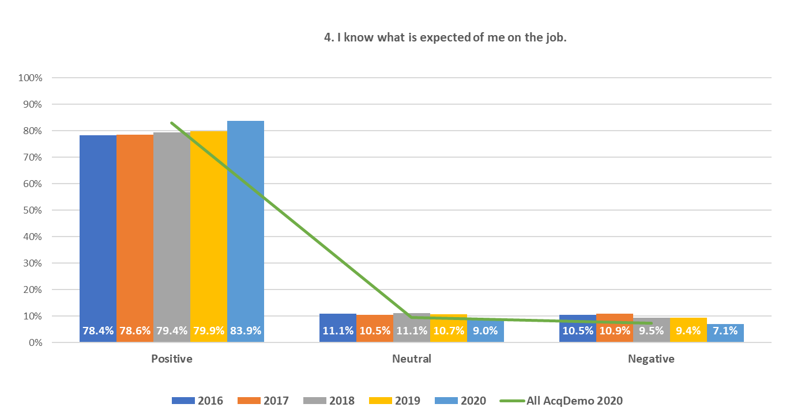
2020 FEVS Item-Level Results Analysis: Army AcqDemo
27

Slide 28
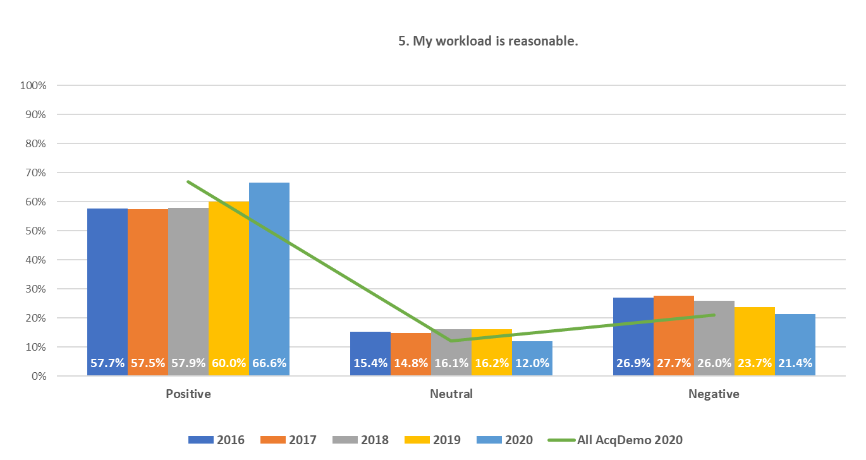
2020 FEVS Item-Level Results Analysis: Army AcqDemo
28

Slide 29
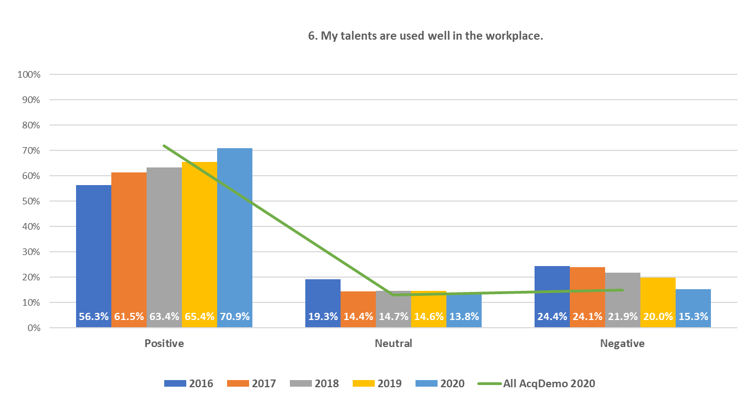
2020 FEVS Item-Level Results Analysis: Army AcqDemo
29

Slide 30
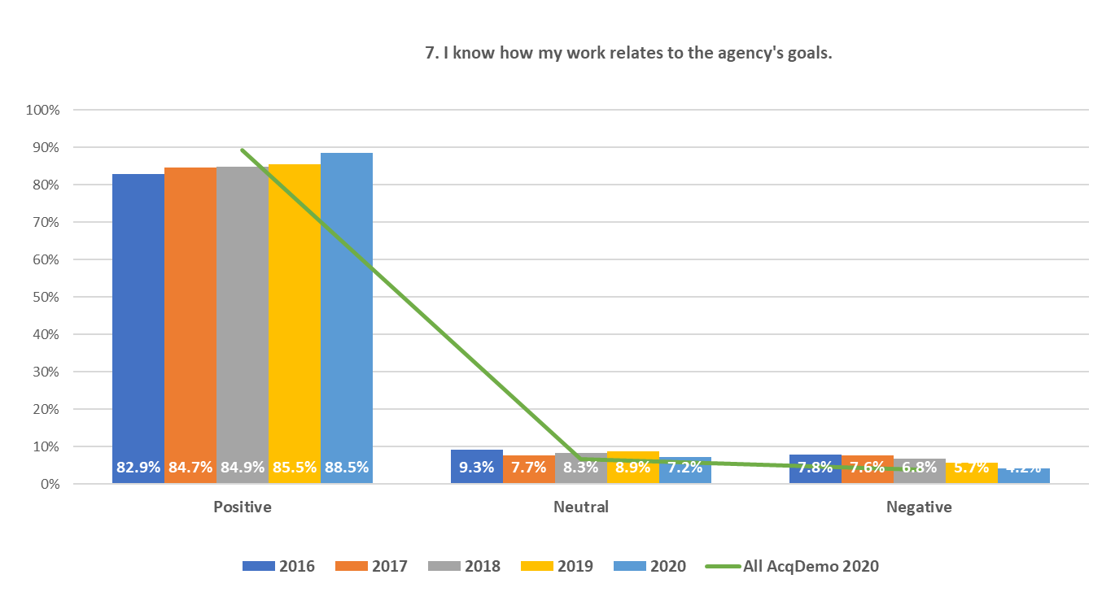
2020 FEVS Item-Level Results Analysis: Army AcqDemo
30

Slide 31
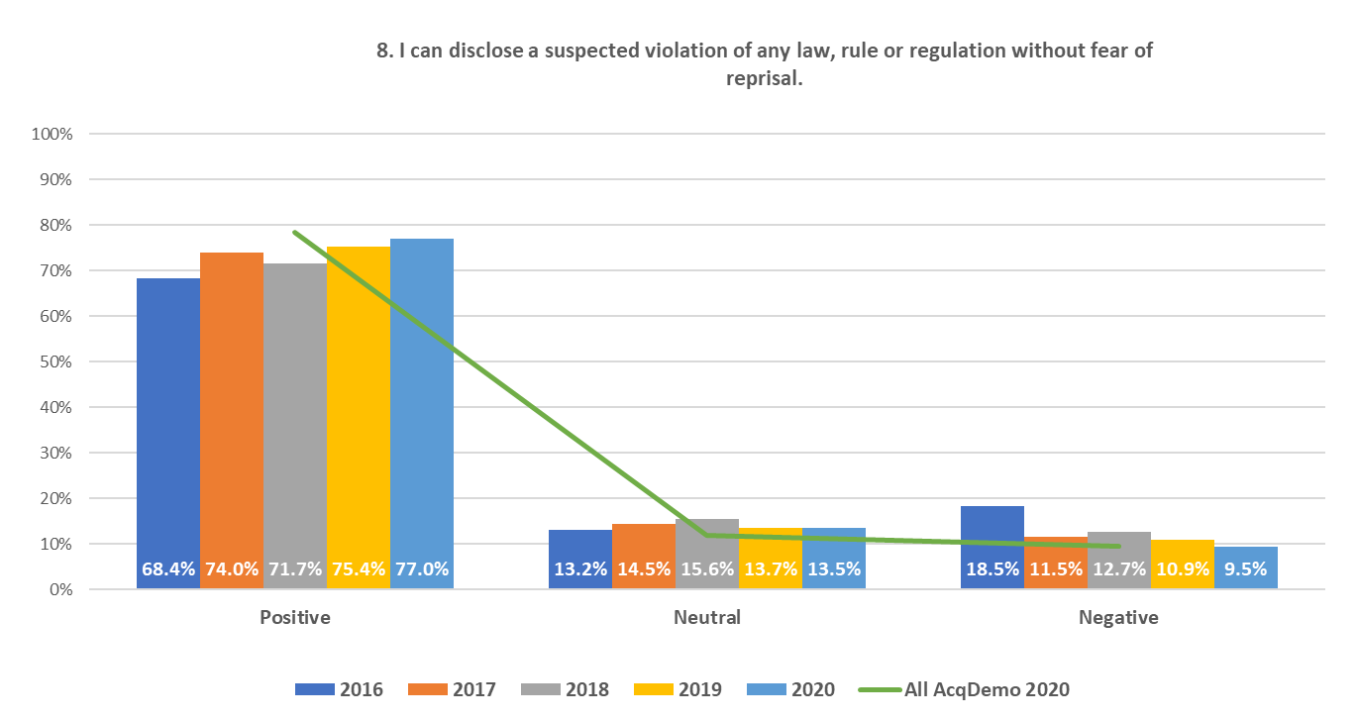
2020 FEVS Item-Level Results Analysis: Army AcqDemo
31

Slide 32
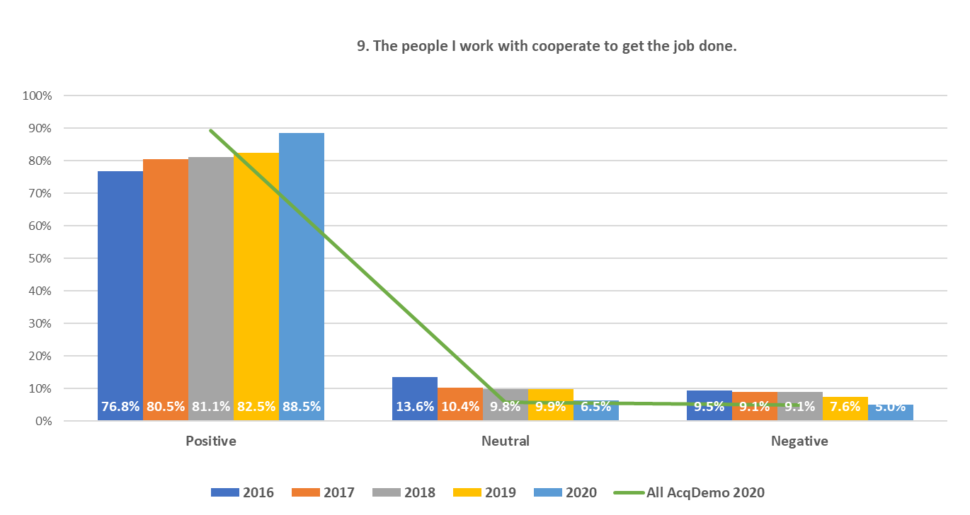
2020 FEVS Item-Level Results Analysis: Army AcqDemo
32

Slide 33
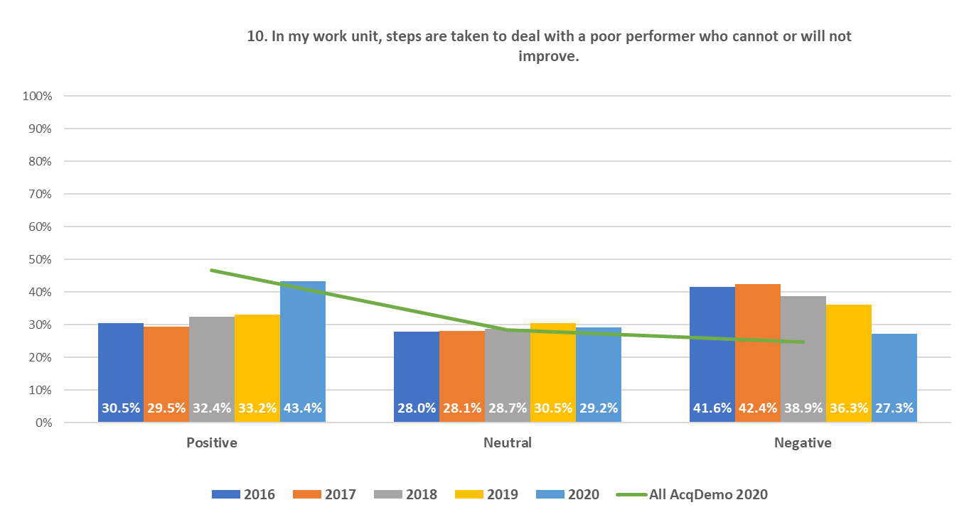
2020 FEVS Item-Level Results Analysis: Army AcqDemo
33

Slide 34
2020 FEVS Item-Level Results Analysis: Army AcqDemo
11. In my work unit poor performers usually
34

Slide 35
2020 FEVS Item-Level Results Analysis: Army AcqDemo
35

Slide 36
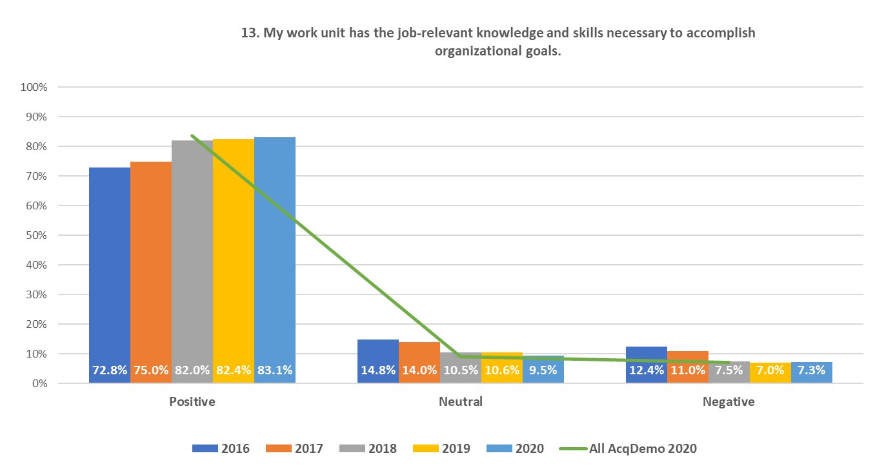
2020 FEVS Item-Level Results Analysis: Army AcqDemo
36

Slide 37
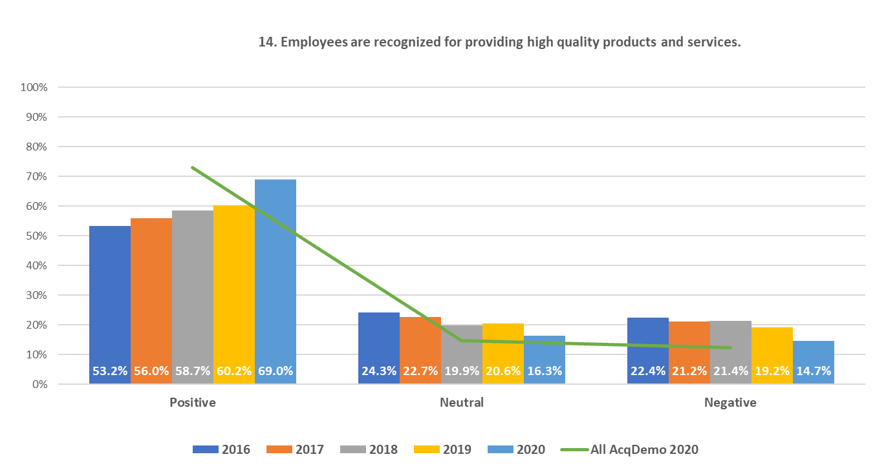
2020 FEVS Item-Level Results Analysis: Army AcqDemo
37

Slide 38
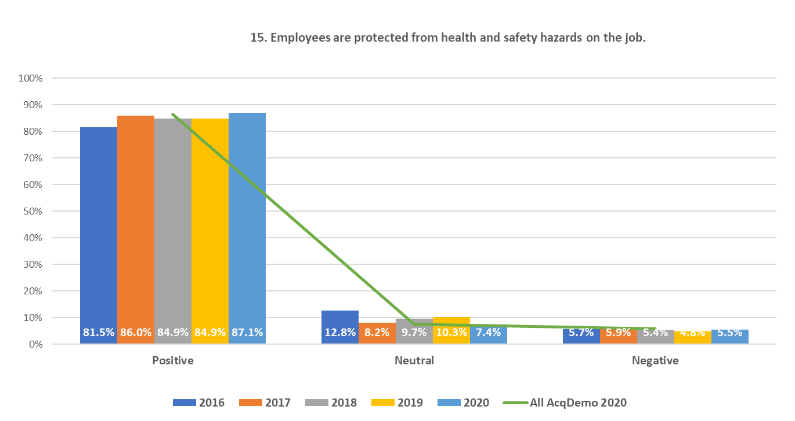
2020 FEVS Item-Level Results Analysis: Army AcqDemo
38

Slide 39
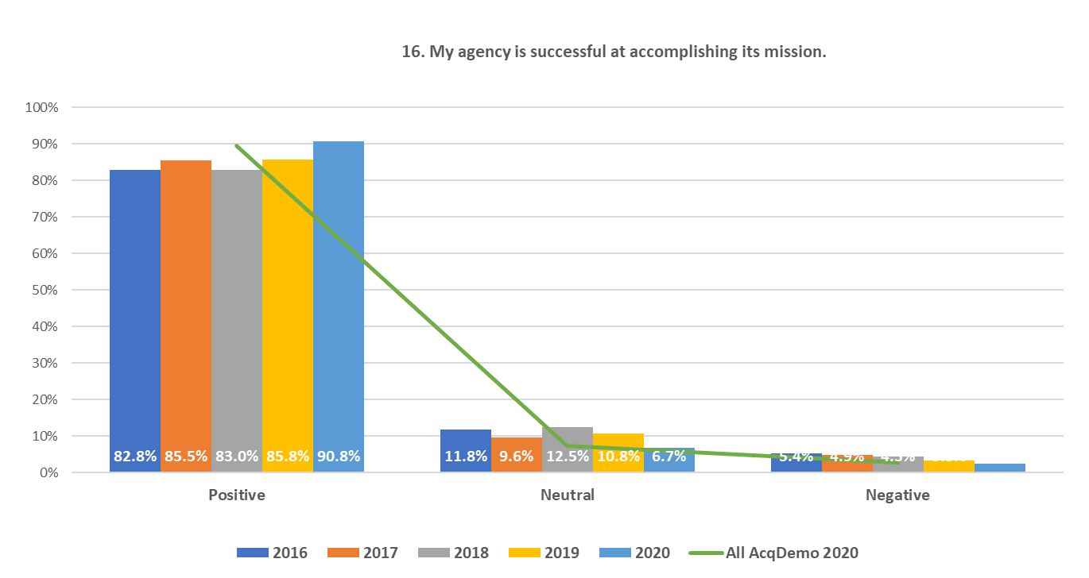
2020 FEVS Item-Level Results Analysis: Army AcqDemo
39

Slide 40
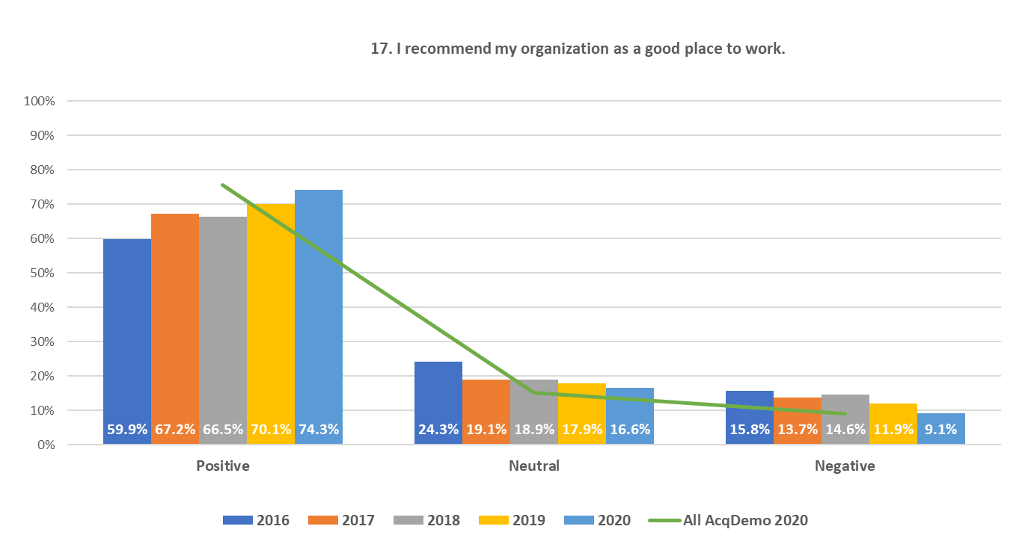
2020 FEVS Item-Level Results Analysis: Army AcqDemo
40

Slide 41
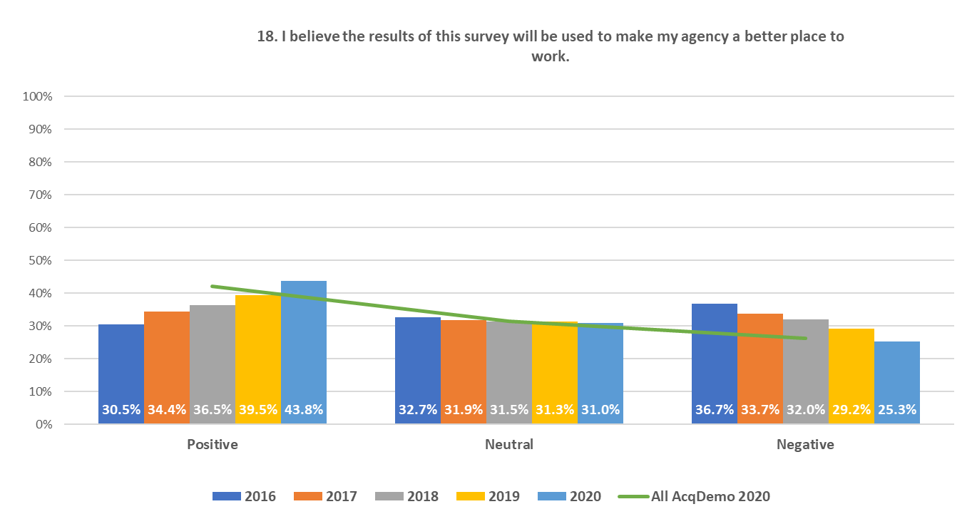
2020 FEVS Item-Level Results Analysis: Army AcqDemo
41

Slide 42
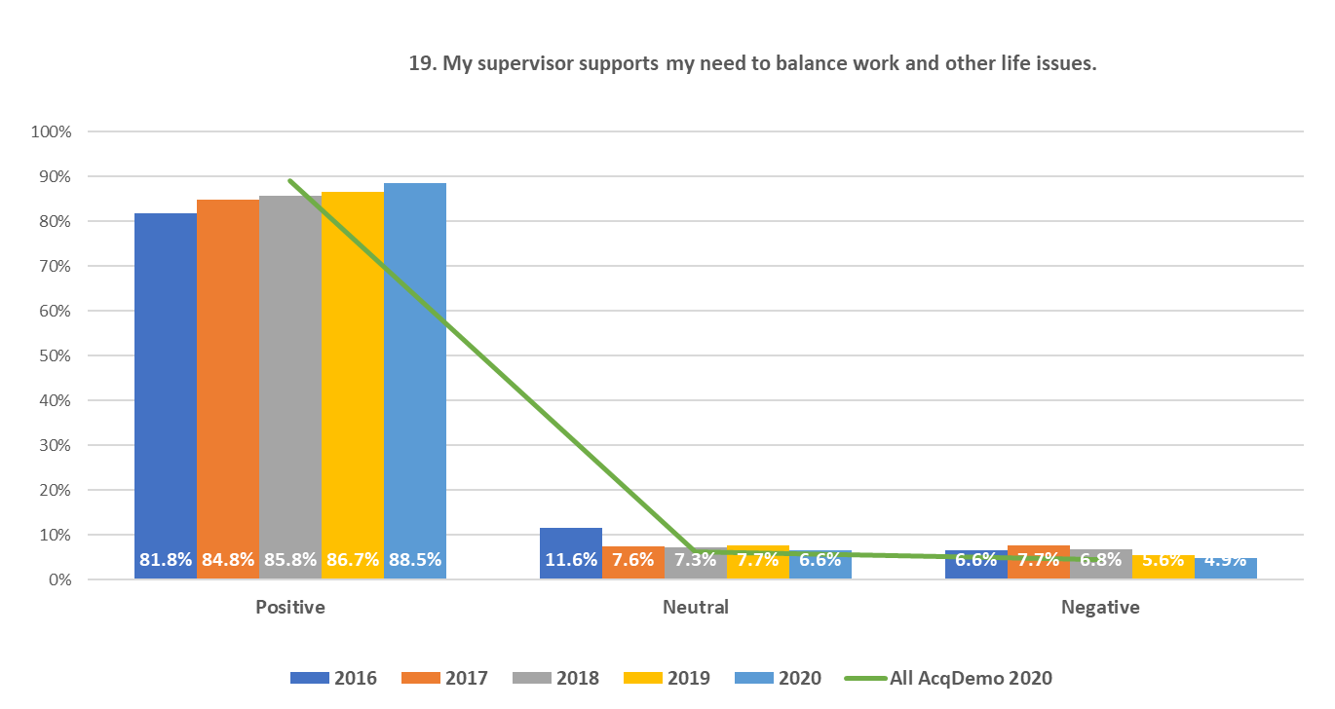
2020 FEVS Item-Level Results Analysis: Army AcqDemo
42

Slide 43
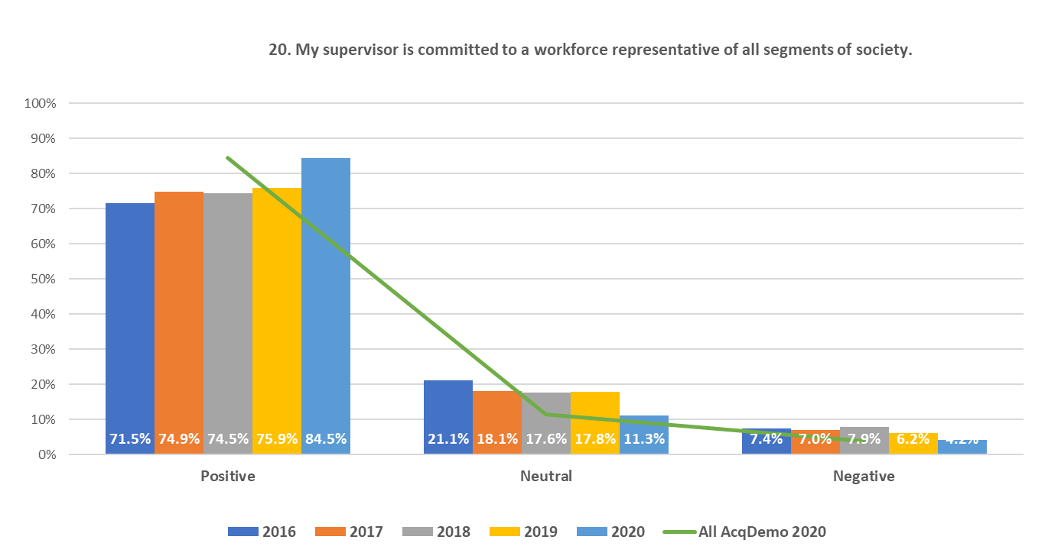
2020 FEVS Item-Level Results Analysis: Army AcqDemo
43

Slide 44
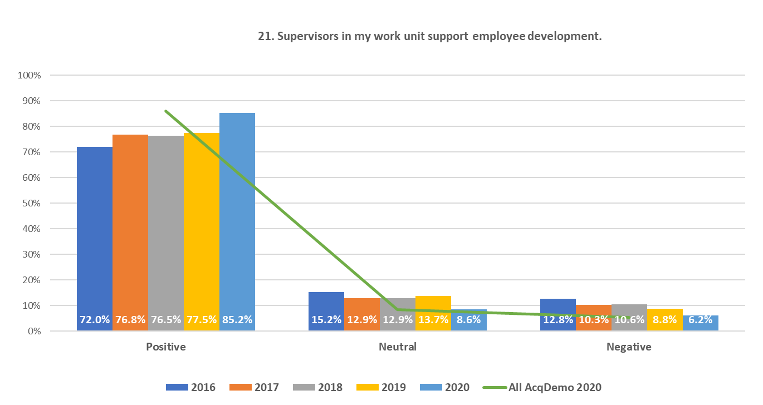
2020 FEVS Item-Level Results Analysis: Army AcqDemo
44

Slide 45
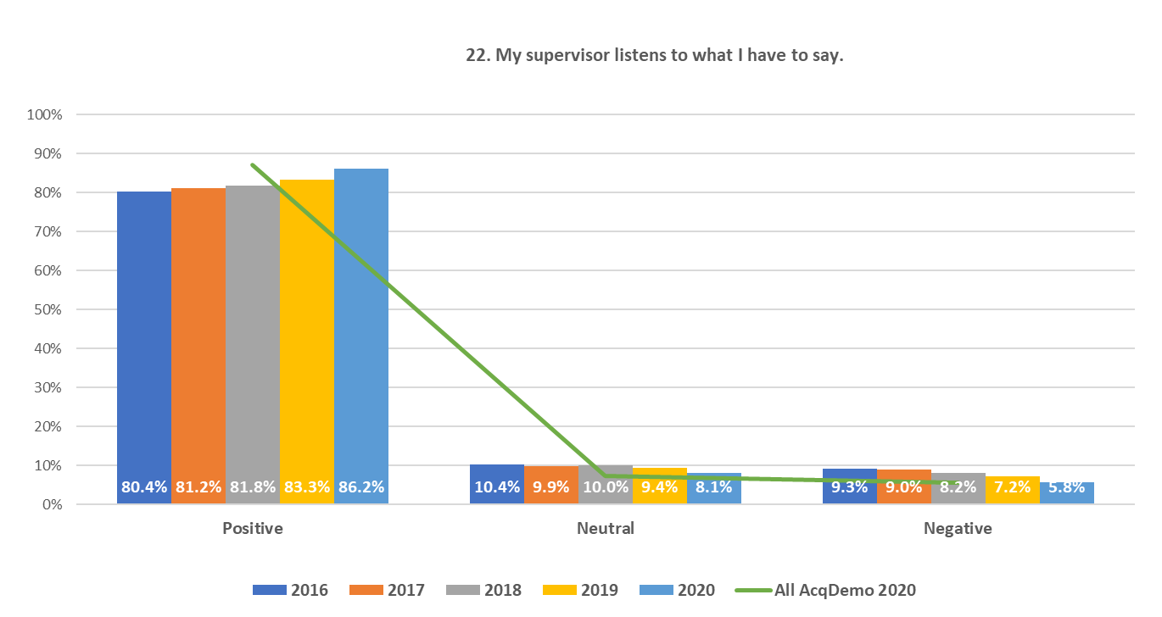
2020 FEVS Item-Level Results Analysis: Army AcqDemo
45

Slide 46
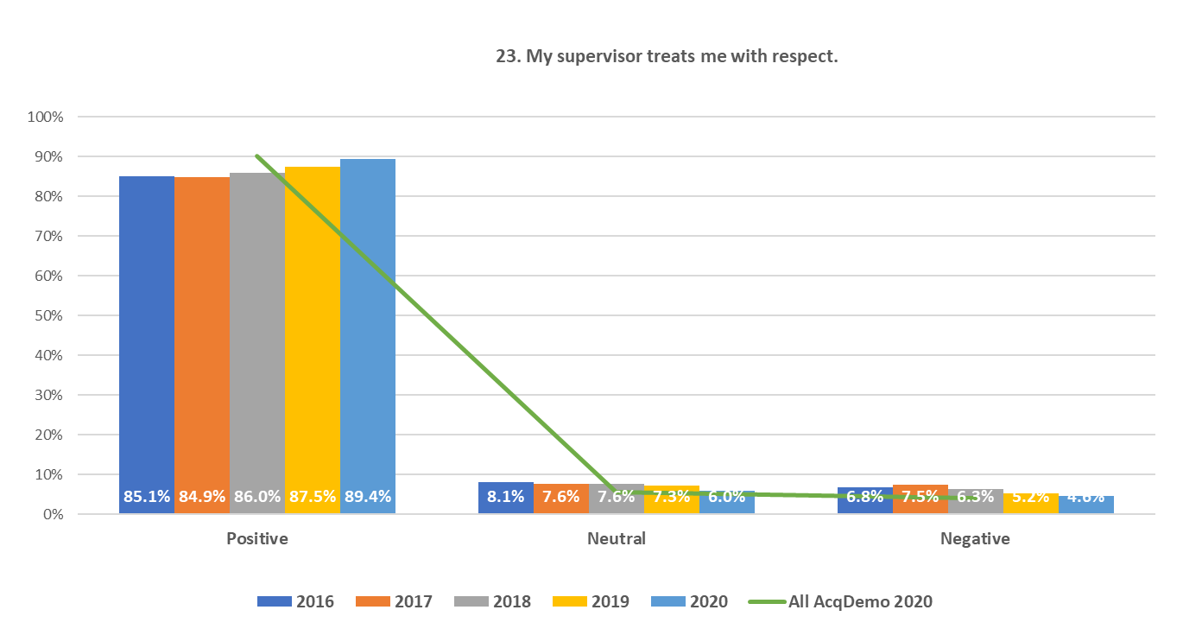
2020 FEVS Item-Level Results Analysis: Army AcqDemo
46

Slide 47
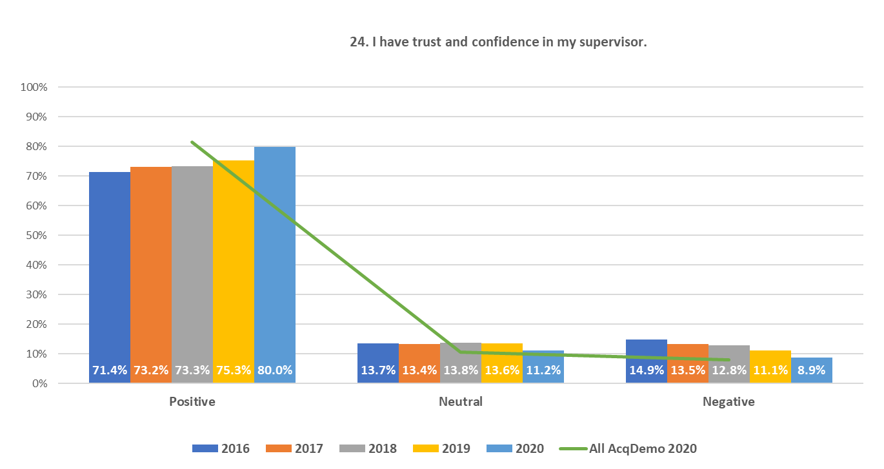
2020 FEVS Item-Level Results Analysis: Army AcqDemo
47

Slide 48
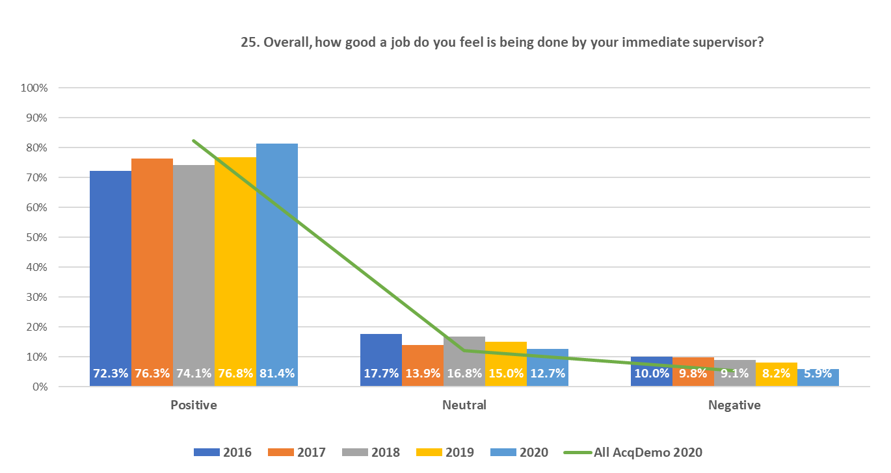
2020 FEVS Item-Level Results Analysis: Army AcqDemo
48

Slide 49
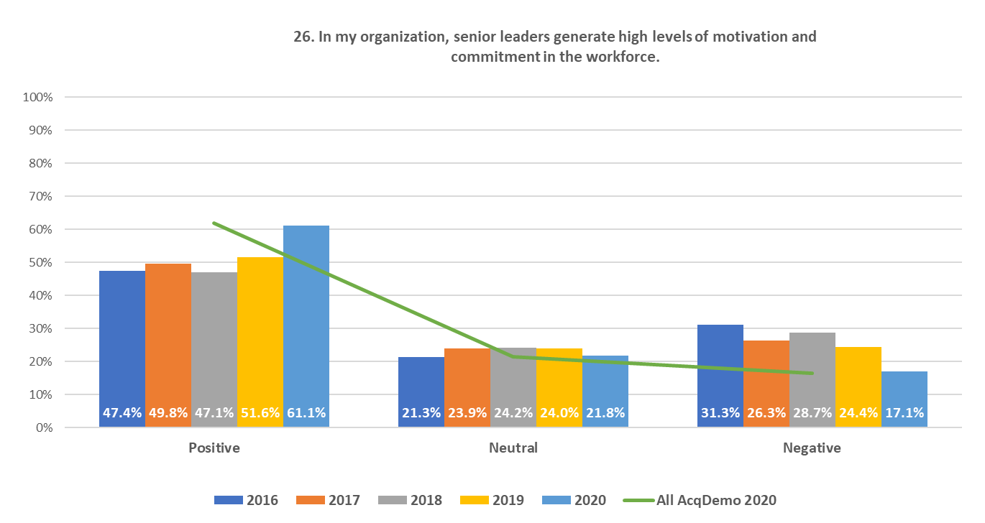
2020 FEVS Item-Level Results Analysis: Army AcqDemo
49

Slide 50
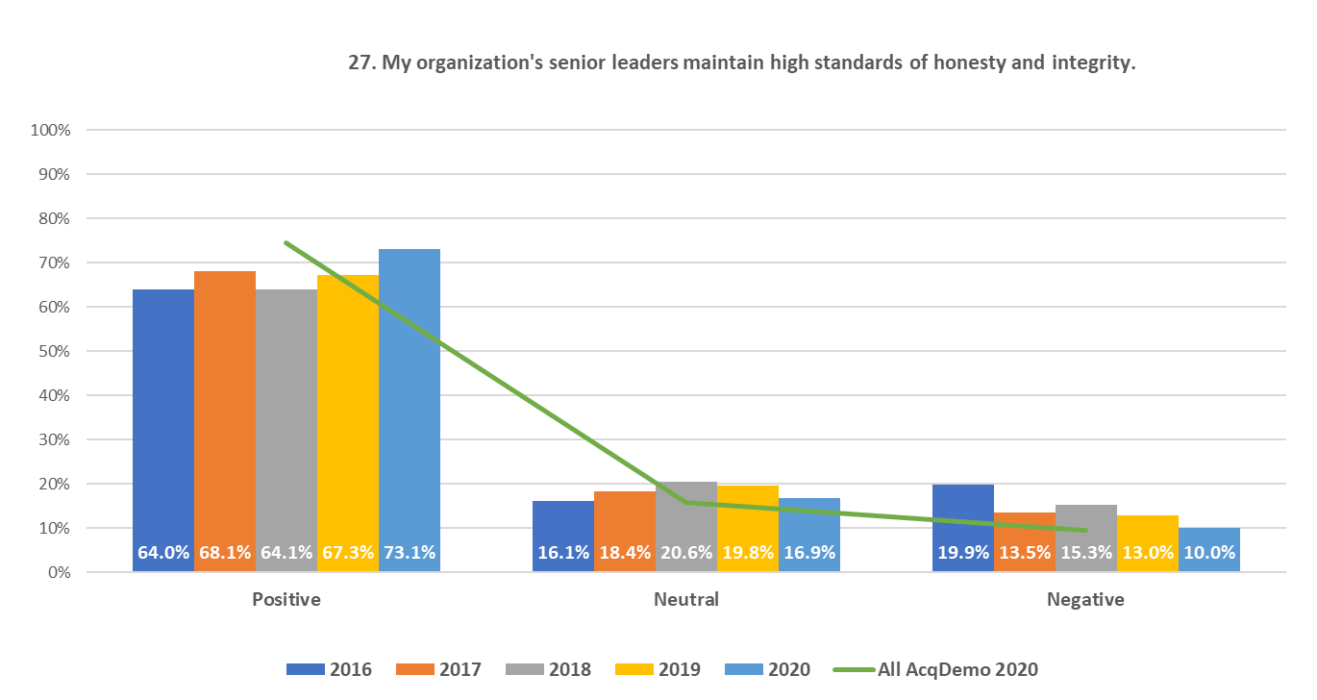
2020 FEVS Item-Level Results Analysis: Army AcqDemo
50

Slide 51
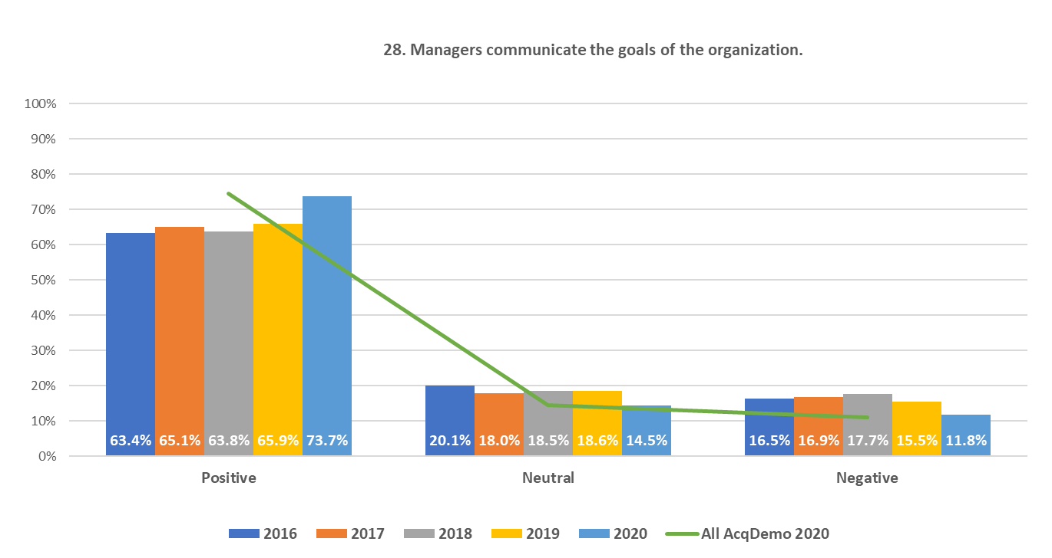
2020 FEVS Item-Level Results Analysis: Army AcqDemo
51

Slide 52
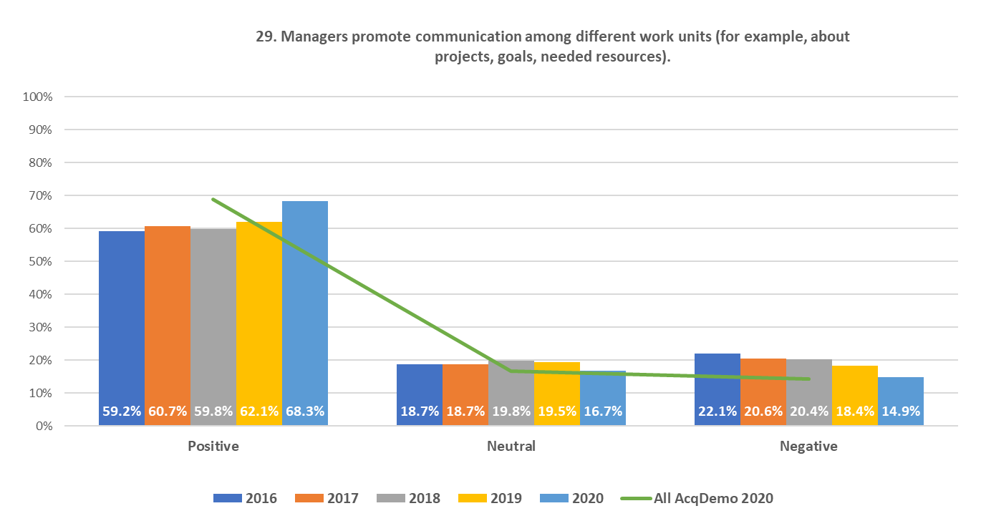
2020 FEVS Item-Level Results Analysis: Army AcqDemo
52

Slide 53
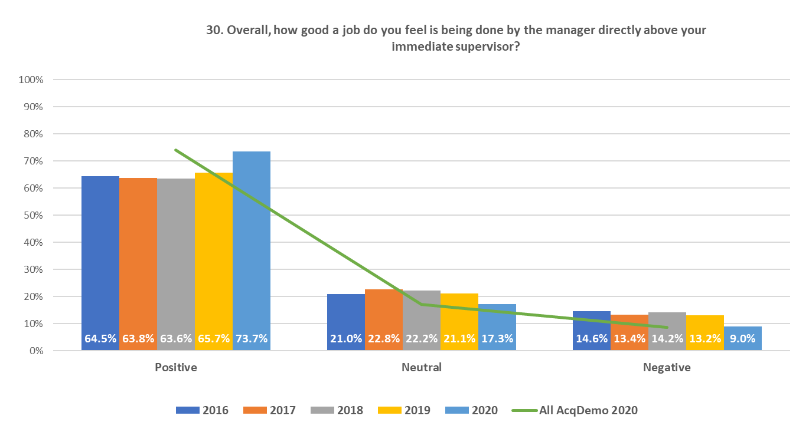
2020 FEVS Item-Level Results Analysis: Army AcqDemo
53

Slide 54
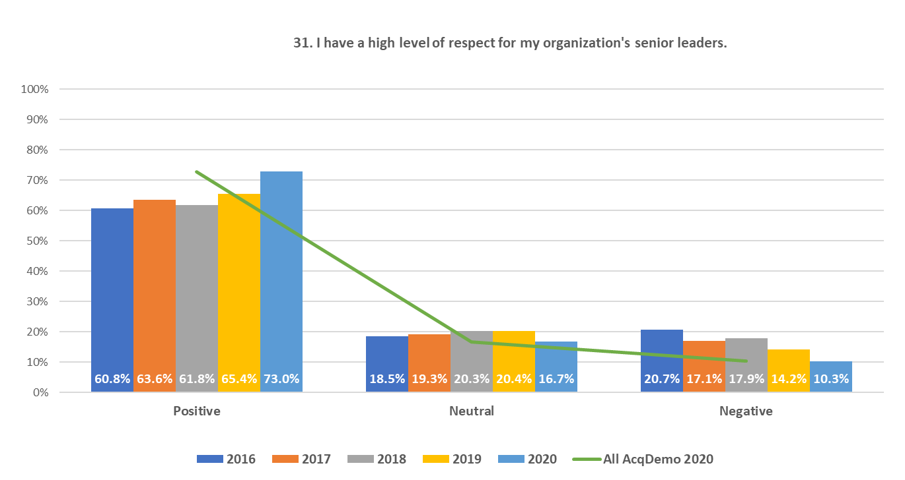
2020 FEVS Item-Level Results Analysis: Army AcqDemo
54

Slide 55
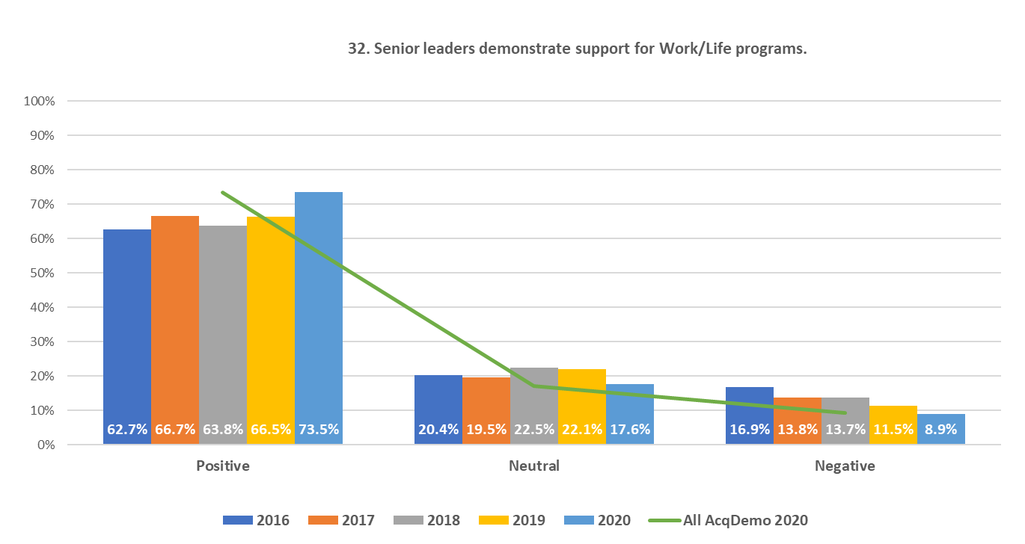
2020 FEVS Item-Level Results Analysis: Army AcqDemo
55

Slide 56
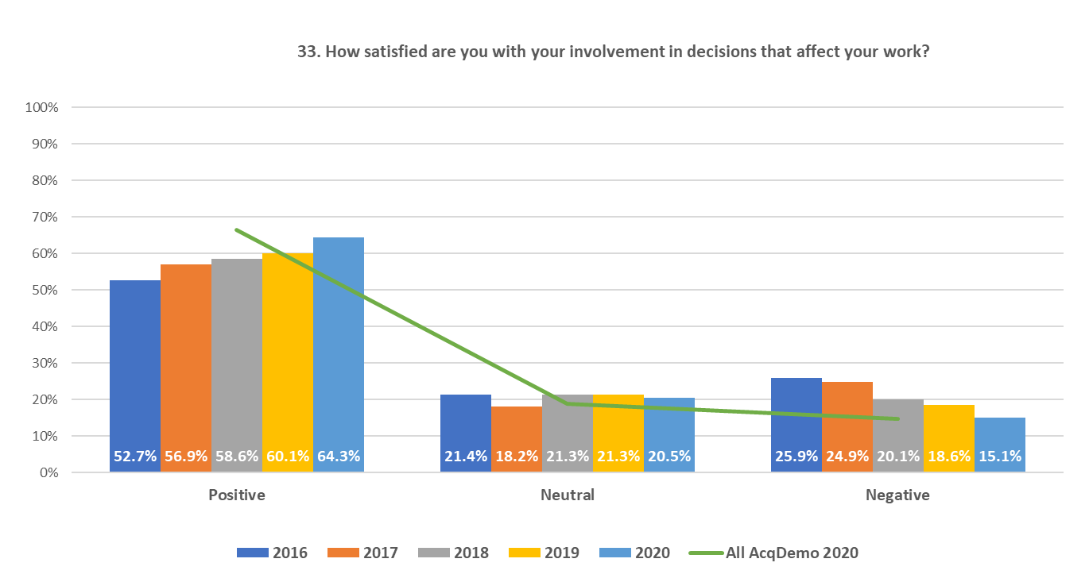
2020 FEVS Item-Level Results Analysis: Army AcqDemo
56

Slide 57
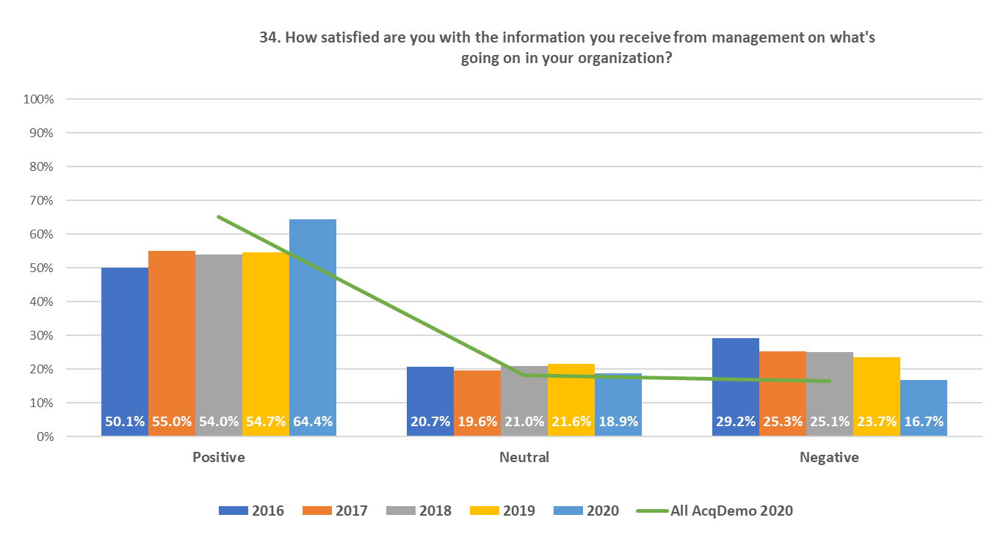
2020 FEVS Item-Level Results Analysis: Army AcqDemo
57

Slide 58
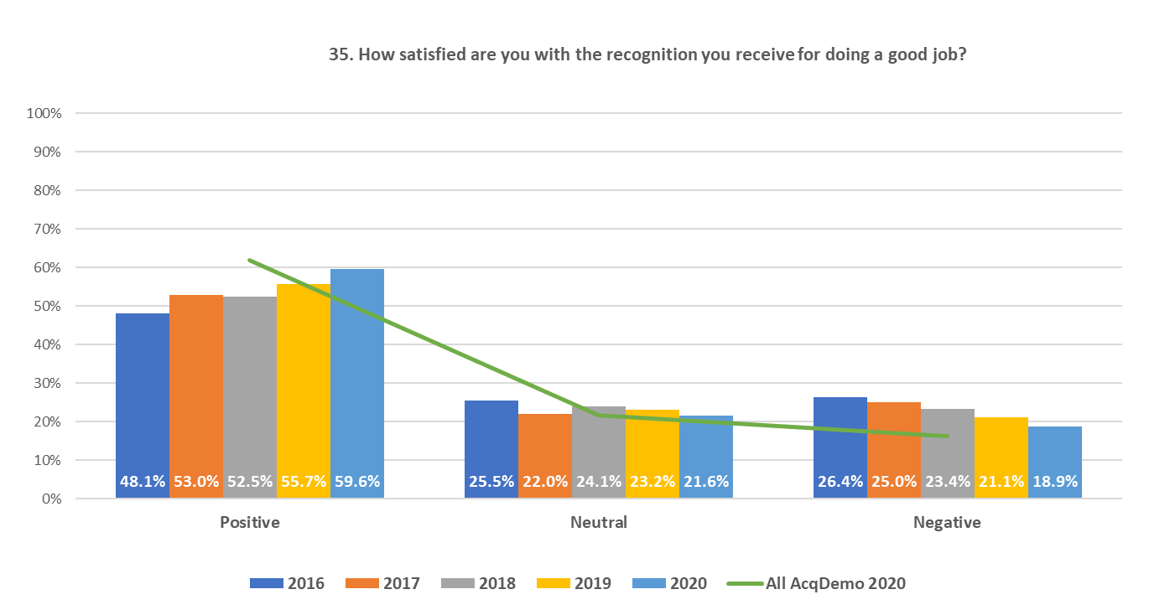
2020 FEVS Item-Level Results Analysis: Army AcqDemo
58

Slide 59
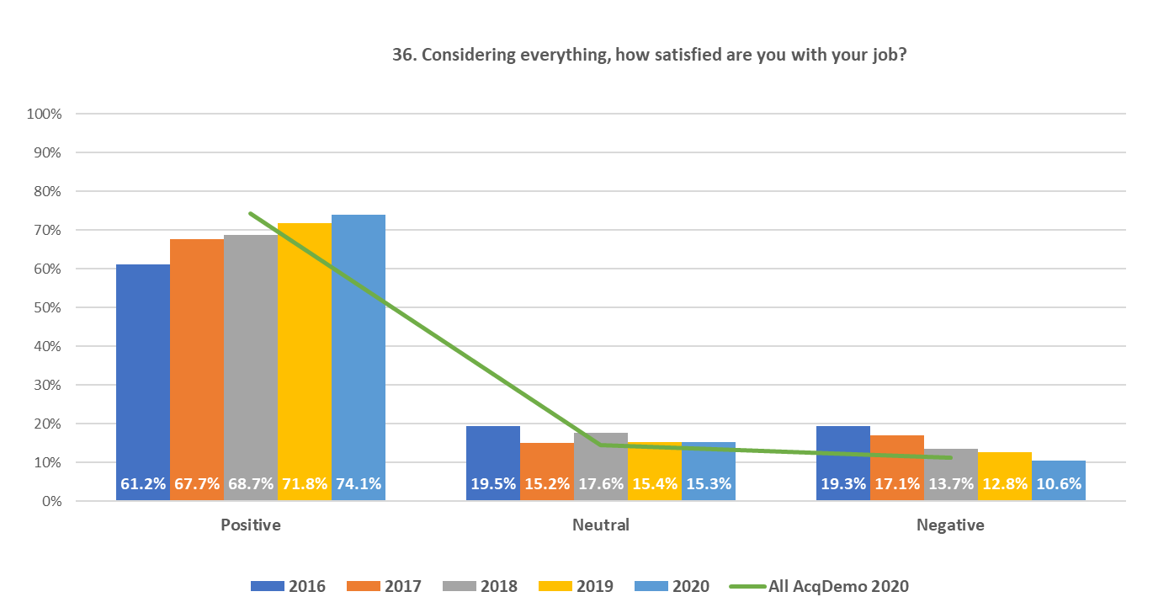
2020 FEVS Item-Level Results Analysis: Army AcqDemo
59

Slide 60
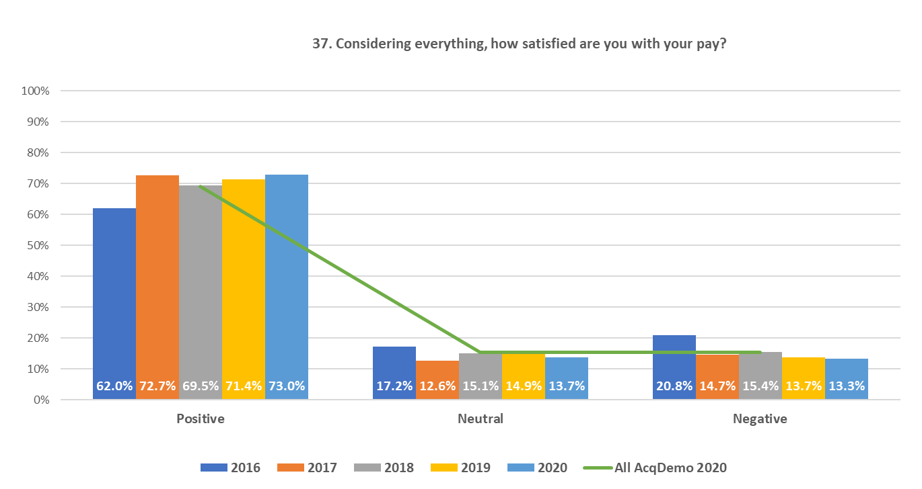
2020 FEVS Item-Level Results Analysis: Army AcqDemo
60

Slide 61

2020 FEVS Item-Level Results Analysis: Army AcqDemo
61

