Slide 1

AcqDemo Pay Pool Panel Member Training
Presented by:
August 2025

Slide 2

Course Objectives
Know the CCAS process
Understand the pay pool panel member’s role and responsibilities
Know AcqDemo policies
Understand how to evaluate assessments
Be aware of available compensation options

Slide 3
CCAS Cycle Overview

Slide 4
CCAS—The Contribution-based Compensation and Appraisal System
Discussion Topics
Design Overview
The CCAS Cycle
The Pay Pool Process
Responsibilities of Supervisors
Responsibilities of Pay Pool Administrators
Responsibilities of the Sub-Pay Pool Panel
Responsibilities of the Pay Pool Panel
4
Notes:
Because CCAS is an appraisal system with unique aspects and is a large part of the Demo project, an entire class has been dedicated to this topic. This chapter then will simply provide a brief overview of CCAS. More details will be provided in future just-in-time CCAS training courses. Let’s begin by touching on these CCAS topics…..(outline on slide)

Slide 5

Design Overview
Another approach to performance management…
…with two key differences:
Designed to focus employees on creating impact
Acquisition is a knowledge-based business—we depend on people to use their knowledge to advance mission performance
Discussing employee expectations will focus
on contribution planning vs. performance
objectives
Shapes professional acquisition workforce
by using three standard factors to score
employee contributions
Notes:
This section provides an introduction to the appraisal and reward system of AcqDemo. It is called the Contribution-based Compensation and Appraisal System, or CCAS for short. We will highlight its key elements throughout this section.
~ CLICK ~
AcqDemo is designed to focus employees on creating impact. Acquisition is a knowledge-based business; we depend on people to use their knowledge to advance mission performance.

Slide 6

Design Overview
Another approach to performance management
…two key differences:
Designed to align compensation with level of contribution
Basic pay level translates to expected contribution level
Assessed contribution level compared to the expected contribution level to determine compensation eligibility
AcqDemo software applications
facilitate equitable distribution
of pay pool funds
Notes:
~ Fully Automated Slide ~
It is also designed to align compensation with level of contribution.
Let’s look into how the CCAS process works to support those program goals.

Slide 7
The CCAS Cycle
September
October
Employee
Self-Assessment
Start CCAS Cycle
Contribution Planning
Supervisor’s Assessment
Feedback
November -
December
April-May
Mid-Point Review
Pay Pool Panels
January
End-of-Cycle Discussion
and Payout
Notes:
NOTE; Slide animations will continue to play while instructor is speaking.
The AcqDemo appraisal cycle corresponds with the DoD fiscal year (Oct 1-Sept 30). Expected contributions are documented in individual contribution plans each Oct, with a mid-point review around March, and contribution assessments completed the following October at the close of the appraisal cycle.
The three-month pay pool process occurs from Oct-Dec with a payout in January of each year.
Depending on the time of transition into AcqDemo, the first CCAS appraisal cycle may be prorated.

Slide 8

The Pay Pool Process
Employee Self- and Supervisory Assessments
Prepare Pay Panel Forms and Tools
Sub-Panel Meetings
(If applicable)
Pay Pool Panel Process
CCAS Pay Adjustments
Discuss CCAS Results
(Individual and Group)

Slide 9
Responsibilities of Supervisors
Review organizational goals and priorities at start of appraisal cycle
Initiate annual contribution planning and explain Expected Contribution Range (ECR)
Monitor and document employee progress and provide coaching/feedback throughout appraisal cycle
Address contribution and/or performance issues immediately upon identification
Provide mentoring for career development
Conduct a formal Mid-Point Review
Request Annual Appraisal Self-Assessment
Complete an end-of-cycle Annual Appraisal
To determine preliminary scores, use factor descriptors for categorical scores, discriminators for numerical scores, and expected contribution criteria for performance appraisal quality levels so as to recommend scores to the pay pool
Participate in pay pool process as required
Conduct Annual Appraisal conversation
Notes:
Ok, let’s take you through an example of how someone is reviewed under CCAS….
The pay pool panel process provides an opportunity to evaluate how the contributions and performance of each individual in the pay pool have led to the accomplishment of the overall goals/objectives of the organization in support of the mission.

Slide 10

Special Situations – Presumptive Ratings
Used when employee cannot be evaluated due to circumstances that take the individual away from their normal duties or duty station
Long-term full-time training
Active military duty
Extended sick leave
Qualified family and medical leave
Full time union representation
Leave without pay, etc.
Pay Pool Administrator will reflect appropriate coding in the CCAS spreadsheet, which will be reflected in the employee’s approved Part I – CCAS Appraisal Form
Notes:
Refer to AcqDemo Ops Guide Chapter 6, section 6.17 for greater detail regarding presumptive rating recommendations.

Slide 11
Special Situations – Presumptive Ratings
Rating official selects from 1 of 5 presumptive status options
Presumptive Status 1—New AcqDemo hires with less than 90 calendar days immediately preceding September 30th who are ineligible for a CCAS rating
Presumptive Status 2—Renders an OCS equal to an EOCS and PAQL of Level 3–Fully Successful. Presumes employee is contributing commensurate with the current basic pay
Presumptive Status 3—Re-certifies employee’s last assessed OCS if greater than current EOCS AND last PAQL was higher than expected
Notes:
Refer to AcqDemo Ops Guide Chapter 6, section 6.17 for greater detail regarding presumptive rating recommendations.

Slide 12
Special Situations – Presumptive Ratings
Rating official selects from 1 of 5 presumptive status options
Presumptive Status 4—Applied to employees with prolonged absence due to work-related injury or full-time union representation duties AND who do not have an official rating of record within the 4-year period preceding the “cut-off date” of a RIF. Renders an OCS equal to their EOCS and PAQL of Level 3–Fully Successful.
Presumptive Status 5—Applied to employees absent for military service
Meets 90-day minimum working under an approved contribution plan – assessed under normal CCAS assessment process
Does not meet 90-day minimum AND no previous rating of record – assigned OCS equivalent to EOCS and “most frequently given” rating of record in competitive area
Does not meet 90-day minimum AND has a previous rating of record – receives OCS equivalent to EOCS and PAQL consistent with previous rating of record
Notes:
Refer to AcqDemo Ops Guide Chapter 6, section 6.17 for greater detail regarding presumptive rating recommendations.

Slide 13
FY2025 Deferred Resignation Program
The DRP allowed approved federal employees to resign with a deferred date
During this period, employees were generally not expected to work and may look for another job
Check your business rules to see if annual assessments are required
Compensation eligibility varies by organization. Options may include:
Employees may be given a Presumptive Status 2 which assigns the EOCS (Delta 0) and a PAQL 3 score for each factor
Providing any earned awards in full
Prorating any earned awards based on work completed prior to resignation
Denying any pay pool awards
Providing non-CCAS monetary awards
Check your local business rules for further guidance.
Notes:
Refer to AcqDemo Ops Guide Chapter 6, section 6.17 for greater detail regarding presumptive rating recommendations.

Slide 14

Responsibilities of Pay Pool Administrators
Pay Pool Administrators have several roles within their organization
Ensuring Pay Pool Members achieve their required milestones throughout the cycle
Maintaining the CAS2Net database with their pay pool’s information
Facilitating the Pay Pool process
Analyzing the results of the Pay Pool
Notes:
Ok, let’s take you through an example of how someone is reviewed under CCAS….
The pay pool panel process provides an opportunity to evaluate how the contributions and performance of each individual in the pay pool have led to the accomplishment of the overall goals/objectives of the organization in support of the mission.

Slide 15
Responsibilities of Pay Pool Administrators
The role of the Administrator during the pay pool/sub pay pool:
Prepare Pay Pool Books and Spreadsheets with accurate data
Update Spreadsheets to capture Panel decisions
Take minutes during Pay Pool Panel meeting of Panel discussions
Ensure needed updates happen to Supervisory appraisals
Keep discussions focused on task at hand
Notes:
Ok, let’s take you through an example of how someone is reviewed under CCAS….
The pay pool panel process provides an opportunity to evaluate how the contributions and performance of each individual in the pay pool have led to the accomplishment of the overall goals/objectives of the organization in support of the mission.

Slide 16
Responsibilities of Pay Pool Administrators
There are two main areas of focus when recording minutes for during Pay Pool Panel discussions:
Employee Scores and Appraisal Review
Reasoning behind scoring changes
Why further clarification may be needed in appraisal
Justification for any scores deemed to be inappropriate/red flags
Organizational AcqDemo Processes (Lessons Learned)
Any changes or additions needed in business rules or compensation strategy
Appraisals that were deemed written well/poorly by panel
Any process changes wanted/needed for future cycles
Notes:
Ok, let’s take you through an example of how someone is reviewed under CCAS….
The pay pool panel process provides an opportunity to evaluate how the contributions and performance of each individual in the pay pool have led to the accomplishment of the overall goals/objectives of the organization in support of the mission.

Slide 17

Responsibilities of the Pay Pool Panel
Review recommended Categorical, Numerical and PAQL scores
Adjust for equity and consistency
Reconcile preliminary ratings that are poorly documented or outside the business rules
Consult with rating official for clarification/justification
Pay Pool Manager is the final approval authority for appraisals and scores prior to submittal to the Personnel Policy Board for review
Review relative value of contributions
Compare ratings among like occupations, career paths and broadbands
Consider promotion salary increases and monetary awards received during rating period
Ensure compensation decisions result in equity and consistency across the pay pool
Adjudicate Requests for Reconsideration and challenges to ratings of record
17
http://acqdemo.hci.mil
Notes:
Under AcqDemo, you are a member of a pay pool. A pay pool is a group of employees who are evaluated together under AcqDemo’s performance management system, the Contribution-Based Compensation and Appraisal System, or CCAS. Their purpose is to share a common view of the organization’s mission, goals, and objectives in reviewing the contribution and performance of employees by subordinate supervisors and bring a common perspective to how employees are evaluated, and therefore, compensated and appraised.
Pay pools are established within each participating organization to evaluate how the contributions of each individual employee in the pay pool have led to the accomplishment of the overall goals/objectives of the organization in support of its mission. Pay pools are typically based either on organizational structure (for example, all employees in a division or a directorate would be in the same pay pool), by functional area, or by geographic location. A pay pool should consist of between 35 and 300 employees. Pay pools may further be broken down to sub pay pools if desired by the Personnel Policy Board.
Each pay pool is led by a pay pool manager, a person within the pay pool who is responsible for managing the CCAS process within their authority. As such, the pay pool manager has annual pay adjustment authority though determinations made by the pay pool manager are subject to higher management review.
The pay pool panel is a group of people who normally report directly to the pay pool manager. Together, along with the pay pool manager, they determine employees’ final Overall Contribution Scores, pay adjustments, and contribution awards.
The use of pay pool panels ensures that individual supervisor’s preliminary scores are reviewed by their peers, again, typically other supervisors in the same pay pool. A pay pool panel member shall not recommend or set his/her own rating or pay.

Slide 18
CCAS Scoring Criteria

Slide 19

Discussion Topics
Appraisal Criteria — The Factors
Contribution vs. Performance
Factor Level Descriptors and Discriminators
Categorical Scores
Numerical Scores
Very High Scores
Quality of Performance / PAQL Scores

Slide 20
Contribution vs. Performance
CONTRIBUTION
Links pay and awards to contribution to the mission and value of the position rather than longevity
PERFORMANCE
Quality of performance an employee demonstrates in achieving his/her expected contribution results under each of the three contribution factors
Descriptors/Discriminators
Narrative statements that are written at increasing levels of complexity, scope and value of the position and employee expected contribution
Expected Contribution Criteria
Quality of performance an employee demonstrates; further explain in the contribution plan for each individual if necessary
Categorical/Numeric Scores
Determined by comparing employee’s contribution results to the set of descriptors and discriminators for a particular factor and broadband level
PAQL Criteria
Employee’s level of performance during the appraisal cycle. Employee’s contribution and the impact of the quality of contributions on the organization
Notes:
To summarize, performance is a component of contribution, but contribution is broader in that it measures an employee’s contribution and value of results to the
mission. OCS is used to determine compensation; performance rating of record is used to determine order of retention in case of a RIF.

Slide 21
Contribution Appraisal Criteria–The Factors
Mission Support
Communication and/or Teamwork
Job Achievement and/or Innovation
Understanding and Execution of Organizational Goals and Priorities
Working with Customers to Develop a Mutual Understanding of their Requirements
Monitoring and Influencing Cost Parameters or Work, Tasks, and Projects
Establishing Priorities that Reflect Mission and Organizational Goals
}
Qualifications
Critical Thinking
Calculated Risks
Problem Solving
Leadership
Supervision
Personal Accountability
Communication (Verbal and Written)
Interactions with Customers, Coworkers, and Groups
Assignments Crossing Functional Boundaries
Determine a categorical and numerical contribution score for EACH factor
Must score contributions to mission and performance separately
Average 3 factor scores to get the Overall Contribution Score (OCS)

Slide 22
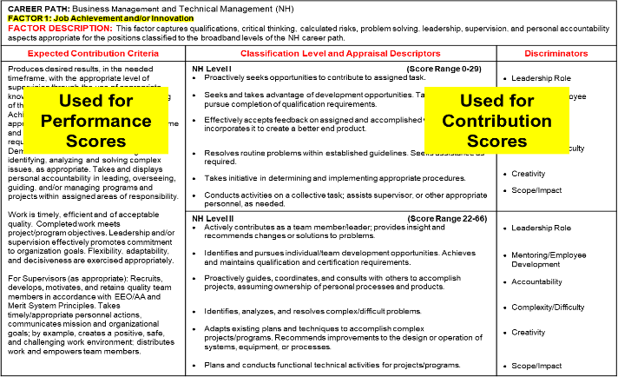
Factor Level Descriptors and Discriminators

Slide 23
Using Factor Descriptors and Discriminators
Factor 1: Job Achievement and/or Innovation for NH-III
LEVEL DESCRIPTORS | DISCRIMINATORS
LEVEL III
Considered a functional/technical expert by others in the organization; is regularly sought out by others for advice and assistance. Pursues or creates certification, qualification, and/or developmental programs and opportunities for self and others. Guides, motivates, and oversees the activities of individuals and teams with focus on project/ program issues. Assumes ownership of processes and products, as appropriate. Develops, integrates, and implements solutions to diverse, highly complex problems across multiple areas and disciplines. Develops plans and techniques to fit new situations to improve overall program and policies. Establishes precedents in application of problem-solving techniques to enhance existing processes. Defines, directs, or leads highly challenging projects/programs | Leadership Role Mentoring/Employee Development Accountability Complexity/Difficulty Creativity Scope/Impact
Use Descriptors for
Categorical Scores
Use Discriminators for Numerical Scores

Slide 24
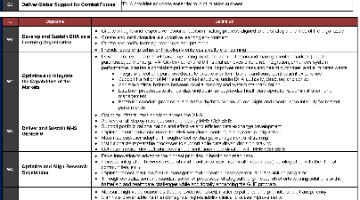
NH-III Self Assessment Example
Job Achievement and/or Innovation – Descriptors: 1, 4, 5
W: Implemented and provided training on a new application for the CMO Contracts Team called the FOHR Tracking Tool.
R: The Tool allows ACO/CAs to improve and streamline the Audit process, from requesting the contractors ICPs to final close out of the overhead record in ONeT. Results on the Tool have led to a focus of clean up on delinquent records, resulting in about 20 records to be further reviewed, annotated & progress made toward closure. Closure of an additional 4 overage records in SEP allowed CMO to meet & exceed metric. (J4, J5)
Was sought out for advice from the Region on the Automated Audit process & how it differs between the CONUS & OCONUS environments. Created a DCMA CMO SOP that outlines approach to monitoring Audits. (J1)
I: The Tool provided CMO more enhanced acquisition decision making abilities by modernizing our contracting tools, aligning with Strategic Plan Line of Effort 2, and specifically Objective 2.1. It also allowed CMO to strengthen execution through cross-functional collaboration with Pricing & CMO auditors, aligning with Objective 2.3.
1102 - NH III – OCS 81
Supervisory Contract Specialist
Strategic Map W2: Optimize and Integrate the Capabilities of the Markets
Factor Descriptor:
Job Achievement and/or Innovation
24

Slide 25

Elements of a Supervisory Appraisal
Statement of validity of factual elements identified in employee self-assessment (concur, partially concur, do not concur)
Any important contributions the employee may have missed (if applicable)
Using Factor Discriminators as the basis, a summary of the value of the employee’s contributions to the mission that supports their numeric score recommendation
A statement of the quality of the employee’s performance that supports their PAQL score recommendation (extra written documentation suggested if recommending a 5 or a 1)

Slide 26
NH-III Supervisor Appraisal Example
1102 - NH III – OCS 81
Supervisory Contract Specialist
Strategic Map W2: Optimize and Integrate the Capabilities of the Markets
Factor Descriptor:
Job Achievement and/or Innovation
Job Achievement and/or Innovation – Descriptors: 1, 2, 4, 5
I concur with the employee’s self-assessment.
Jane’s mentorship has led to an exceptionally high performing team with excellent morale, which is particularly impressive because 3 of her people sit in a different office 2 time zones away. Also acquired personal 40 CLPs. (J2)
Leadership: Jane and her team handle more workload than 2 of the 4 CMOs combined and has achieved every Agency reported metric in FY20. She took on a strong leadership role in the multifunctional Past-FDD Working Group, which resulted in a CMO total reduction of 284 contracts, from 1,255 to 971, within four months’ time: this is the first time that this metric has improved in several years.
Complexity/Difficulty: Jane made great strides in performing remote surveillance, working with the CPSR team to perform remote reviews of contractor business systems for the first time, including cybersecurity requirement flow downs!
The quality and quantity of Jane’s work substantially exceeds the contribution expectation with minimum room for improvement. And her application of technical knowledge and skills goes well beyond that expected for the position.

Slide 27
Determining Categorical Scores
14 overall Factor descriptors that are used to determine a categorical score:
High: Employee consistently and independently meets full intent of all factor descriptors during the appraisal cycle
Meet all 14 descriptors - 6 for Job Achievement and/or Innovation, and 4 for other two factors
Medium: Employee meets most (defined as more than half) factor descriptors during the appraisal cycle with minimal guidance
Meet 4-5 descriptors for Job Achievement and/or Innovation, and 3 for other two factors
Low: Employee consistently meets less than most factor descriptors during the appraisal cycle or needs greater than expected assistance in meeting them
Meet at least 1 descriptor per factor
Note: This is NOT the only possible criteria for rating, but can be used as a starting point in recommending categorical scores

Slide 28
Very High Score
Very High scoring has 3 options – High, Medium and Low with corresponding numerical scores
Factor level descriptors are available to define Very High Score at the mid-level
Same for all 3 factors
Notes:
Very high scores continue to be available to recognize an employee for exemplary contributions and overall quality of performance the results of which are substantially beyond what was expected and warrant a score exceeding the top score for the highest broadband level in the employee’s career path.
Very high scores for factors may only be assigned to employees holding a position in NH IV, NJ IV, or NK III career paths.
=> Factor Level Descriptor for Very High Score has been added to Appendix G, “Classification Level and Appraisal Factors.”
Our organizational policy regarding assigning Very High Scores is XXXX
Federal Register notice, Section II.D.2.f.(1), “Compensation Equity”
…Very high scores are available to recognize an employee for exemplary contributions and overall quality of performance the results of which are substantially beyond what was expected and warrant a score exceeding the top score for the highest broadband level in the employee’s career path. Very high scores for factors may only be assigned to employees holding a position in Level IV of the Business and Technical Management Professional Career Path, Level IV of the Technical Management Support Career Path, or Level III of the Administrative Support Career Path.

Slide 29
Validating Categorical Scores
Things to watch for:
Categorical scores outside of an employee’s expected score range
Compare the employee to other employees within this categorical score. Does the employee match the consistency and independence level of the majority of the other employees given this same categorical score?
Categorical scores that are lower than the expected score score range
Has the employee been given the opportunity to work at a level consistent with the categorical score corresponding to their EOCS
Categorical Scores in higher broadband level
Verify that the employee has done work that is consistent with the higher broadband level and at a level to justify the recommended score. This may require reclassification or a new PRD.
Contributions that are so significant that they warrant a higher categorical score to properly reward the value of the contribution/
May warrant rolling over from CRI to a cash award if this level of contribution is not sustainable.
Note: These anomalies do not mean that a recommended score is wrong, just things that should be considered as you give the score closer scrutiny.

Slide 30
Finalizing Numerical Scores
Review the factor discriminators to establish rank ordering
Job Achievement and/or Innovation
Communication and/or Teamwork
Mission Support
Leadership role
Mentoring/Employee Development
Accountability
Complexity/Difficulty
Creativity
Scope/Impact
Oral
Written
Contribution to Team
Effectiveness
Independence
Customer Needs
Planning/Budgeting
Execution/Efficiency
All broadbands and career paths have the same factor discriminators.
>> The discriminators help to establish relative value of contributions
and place the degree of impact into context. <<

Slide 31
Rating Process
NH Career Path
Job Achievement and/or Innovation Factor
Determine the Categorical Score
Review the Factor Discriminators and knowledge of employee contributions and impact to establish a rank order
Determine the Numerical Score
Numerical Score range must be associated with the respective Categorical Score
Assign a PAQL score for each factor
3 High (3H)
79-83
John, Susan
Dan
Bruce, Rick
James
Rose, Joe
83
82
81
80
79
Apply logic to your thought process and judgment when recommending Categorical and Numerical Scores.

Slide 32
Other Special Considerations
Panel Members should be familiar with the appraisals within their chain of command and be prepared to defend the recommended rating when appropriate.
Any recommended ratings you have discrepancies with, review with rating official for further clarification prior to pay pool meeting
Any recommended ratings that may seem unusual be prepared to clarify any concerns other members may have with ratings
Consider length of time in position or contributions outside of normal contributions for special adjustments in the pay pool
Prorating an employees score based hire date/promotion date when comparing them to an employee contributing at the same level for a full year
Recommending that part of their CRI (base pay increase) be rolled into the CA (bonus) for temporary duties or assignments
Note: First year organizations are more likely to have scoring anomalies. Over time these will become less as the AcqDemo adjusts the compensation levels to better match the value of individual employee contributions.

Slide 33

Quality of Performance
CCAS includes assessment of the quality of performance an employee demonstrates in achieving his/her expected contribution results during an appraisal cycle
Quality of Performance rating assigned to each factor in addition to contribution factor scores
Average of three performance factor ratings translates to the annual rating of record for selection, awards, and RIF purposes

Slide 34
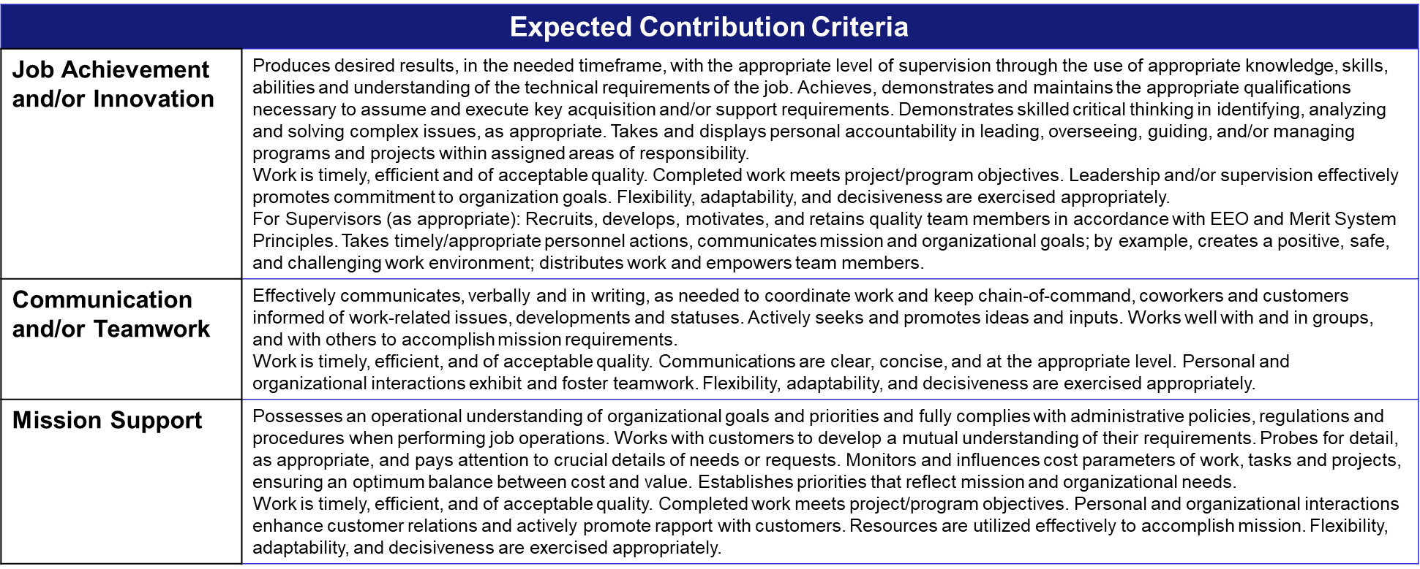
PAQL Expected Contribution Criteria

Slide 35
Determining PAQL Scores
PAQL Score | PAQL Criteria | Examples | Rating Criteria
Level 5 — Outstanding | An employee’s quality of performance exhibited in achieving his/her contribution results substantially and consistently surpasses the factor-specific expected contribution criteria and the employee’s contribution plan goals and objectives. | Employee’s performance made distinguishable outcomes, set precedent, industry-wide recognition, etc. | Average of 3 Scores > 4.3 = 5
Level 3 — Fully Successful | An employee’s performance consistently achieves, and sometimes exceeds, the factor-specific expected contribution criteria and his/her contribution plan goals and objectives. | Employee’s performance gets the job done and sometimes exceeds expectations. | Average of 3 Scores < 4.3 = 3
Level 1 — Unacceptable | An employee’s performance fails to meet the expectations for quality of work and the required results for the goals and objectives set forth in his/her contribution plan for the appraisal cycle. | Employee’s performance shows unsatisfactory quality, quantity or timeliness of work, incomplete, etc. | Any Single Score of 1 = Overall 1

Slide 36
Validating PAQL Scores
Things to consider and watch for
Verifying a level 5 PAQL score
Is there clear evidence in their appraisal to justify the recommended rating?
Are they consistently and substantially surpassing expectations vs sometimes exceeding expectations? Where is that line in your pay pool?
Does your pay pool have a target goal for percentage of 5’s, and would you classify this employee in that top percentage of performers for this factor?
Verifying a level 1 PAQL score
Is there clear evidence of where the employee is failing to meet expectations?
Has the supervisor taken the proper process steps during the appraisal cycle?
Does the employee's failure warrant them being put on a CIP (Contribution Improvement Plan)?

Slide 37
Pay Pool Panel Assessment of Appraisals
Action | Questions
Review the recommended contribution and PAQL scores given Review the appraisals to justify the recommended scores Decide how the value of the contribution impacts the categorical score (i.e., a High versus a Medium) Discuss and reach consensus on approved scores | Are there any inconsistencies between narratives and recommended ratings? What categorical score is appropriate when not all the bullets in the factor descriptor have been met, but the value of the contribution has made a significant impact?
Review and resolve inconsistencies between the categorical and numerical scores Resolve inconsistencies between the contribution and PAQL scores | Are there any inconsistencies within and/or between the contribution rating, PAQL rating and narratives?
Review compensation adjustments that result from the ratings | Any issues? Is this fair and consistent across the Pay Pool?

Slide 38
CCAS Compensation

Slide 39

Discussion Topics
Compensation Management —
Philosophy, Strategy and Policy
Pay Pool Funding
Payout Calculations
CRI Carryover
Supervisory Cash Differentials
The Alphas
Inadequate Contribution
CCAS Administrative Grievance Process
Pay Pool Considerations
Release of Aggregate Results

Slide 40

Compensation Philosophy
AcqDemo’s compensation philosophy embraces three basic principles:
Ensure adequate pay for the duties of the position
Recognize individual competency achievements
Reward contribution to mission
Primary Objective — Compensate employees appropriately for their individual contribution to the organization’s mission and at a level commensurate with the value of their position. The goal is to–
Promote greater compensation for those who are the highest (and most undercompensated) contributors
Encourage the lowest contributors to improve
Appropriately compensate all levels of contribution
Notes:
Federal Register notice, Section C.1., Introduction
…AcqDemo’s compensation philosophy ensures equitable pay for the duties of the position, recognizes individual competency achievements, and rewards contribution to mission. To assist in this endeavor, AcqDemo provides a number of interventions and policies for special situations such as pay setting for new hires, reinstatement eligibles, and non-AcqDemo Federal civilian employees voluntarily accepting an AcqDemo position; promotions; buy-ins on voluntary permanent lateral transfers, reassignments, and realignments into AcqDemo; changes to lower career path; supervisory and team leader cash differentials; accelerated compensation for developmental positions; and a contribution-based compensation system that aligns employees’ pay to their contributions to the organization’s mission and to the scope, difficulty, and value of their positions.

Slide 41

Pay Pool Funding
Contribution Rating Increase (CRI)
· Intended to be consistent with funds historically spent in GS on within-grade increases, quality-step increases and promotions between grades that are now banded
· Minimum of 2% of activity’s total basic pay budget of employees onboard as of 30 September.
General Pay Increase (GPI)
· Accounts for the cost of labor and percentage increase for the GS pay table
Contribution Awards (CA)
· Intended to be consistent with funds historically spent in GS on performance awards
· Minimum of 1% of activity’s total adjusted basic pay budget
· Will not exceed 90% of organization total awards budget
Notes:
Based on the scoring results, the pay pool manager, in consultation with the pay pool panel, determines the potential salary adjustment and contribution award for each employee. Overall, there are three pots of money available to the pay pool for distribution at the end of each appraisal cycle:
The amount of money available within the pay pool for salary increases, here called a Contribution Rating Increase (or CRI), is determined by the money that would traditionally have been available in GS for quality and within-grade step increases, and career promotions. The CRI pool of money will be set at no less than 2% of the activity’s total basic pay budget (without locality). Components may optionally set higher amounts within their budgetary limits, unless a ceiling amount is directed by the AcqDemo Program Office, OPM, and/or OMB within any given year.
The Contribution Award (or CA) pot includes what were formerly performance awards under the General Schedule. This money will be used for awards given under the CCAS process. The fund will be set at no less than 1 % of the activity’s total adjusted basic pay budget (with locality). This fund will not exceed 90 % of the total awards budget, so as to allow for other awards not related to the CCAS process, e.g., on the spot awards and group awards to be given throughout the year.
The General Pay Increase (or GPI) is an optional annual increase recommended by the President of the United States and approved by Congress.
The dollar amounts to be included in the pay pool will be computed based on the total of the basic pay of all employees in the pay pool as of 30 September each year.
Note: Adjusted basic pay includes locality

Slide 42
The “Rails”
$162,672
Standard Pay Line
$140,000
Overcompensated Region
Region “A”
Normal Pay Range
Region “C”
$120,000
Upper Rail
GS-15,
Step-10
Salary
Basic Pay
$100,000
GS-1,
Step-1
Salary
$80,000
Undercompensated Region
Region “B”
$60,000
Lower Rail
$40,000
$22,360
0
Overall Contribution Score
100
42
Notes:
So this is the famous “rails” graph of AcqDemo, now called the Integrated Pay Schedule, or IPS. We’re going to step through how pay adjustments are calculated from CCAS scoring results so you can both understand the process and be prepared to answer questions about pay adjustments should they come up.
This is how the GS-1, step 1 to GS-15, step 10 base pay amounts and their corresponding EOCSs, 0 – 100, plot on a natural logarithmic scale. This logarithm generates what we call the Standard Pay Line (red line) representing all the salaries between GS-1, step 1 and GS-15, step 10. The design provides for a tolerance of plus/minus 8% in base pay amounts or plus/minus 4 OCS points around the SPL. This creates what we call the Normal Pay Region (NPR) and Expected Contribution Range (ECR).
These terms are best described graphically, so we’ll start by building a graph.
The X or horizontal axis represents Overall Compensation Scores.
The Y or vertical axis represents Basic Pay.
To understand compensation regions, certain areas of the graph need to be identified.
First, let’s add the Standard Pay Line. The Standard Pay Line is a mathematical relationship between contribution and salary. It tracks from the lowest pay (GS-1/1) to the highest pay (GS-15/10).
- The line is increased annually IAW the General Schedule pay increase.
Throughout the CCAS discussion , you’ll hear me refer to the Upper and Lower Rails. These rails are the curved lines placed at + and – 8% from the Standard Pay Line and define a region called the Normal Pay Range.
The Normal Pay Range falls between the rails and is the same for all career paths. The Normal Pay range, like the Standard Pay Line, does not include locality pay.
The region above the upper rail is called the “Overcompensated Region” and
The region below the lower rail is called the “Undercompensated Region”. These names will make more sense after a few more elements are explained.

Slide 43
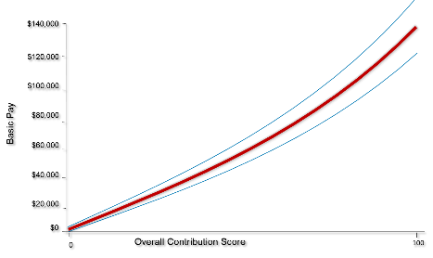



CCAS Reward Payout Criteria
Compensation Category | General Pay Increase | Contribution Rating Increase | Contribution Award | Locality Pay
Overcompensated | Can be given in full, partial or denied | No | No | Yes
Undercompensated | Yes | Yes – up to 20% | Yes | Yes
Appropriately Compensated | Yes | Yes – up to 6% | Yes | Yes
Payout Considerations
Available funding guides pay decisions
Total Adjusted Pay may not exceed Executive Level IV
CRI increases may not exceed max pay for current broadband
CRI increases > 20% and CAs > $10,000 require local commander’s approval
Intent of AcqDemo is to appropriately compensate all employees
Notes:
Depending on the OCS finalized by the Pay Pool Panel, an employee’s contribution will plot in one of three Regions: Overcompensated Region (above the upper rail), Undercompensated Region (below the lower rail), and Normal Pay Region which is the region between the upper and lower rails.
Based on rail position, there are associated salary adjustment guidelines as shown in the table on this slide. Because those in the overcompensated region are being paid more than their level of contribution, they are not eligible for a Contribution Rating Increase (pay increase) nor a Contribution Award. The Pay Pool Panel may decide to give the GPI in full or reduce or deny it altogether. Those who plot in the normal pay region are being compensated fairly for their level of contribution and are, therefore, eligible for a CRI (up to 6%), a CA, and the full GPI. Those plotting in the undercompensated region are contributing well above their current level of compensation and are eligible for a CRI (up to 20%), a CA, and the full GPI. Because locality is not part of the Pay Pool funds, everyone receives their locality adjustment.
These percentages are eligibilities…the actual amount of increase will again be dependent upon the Pay Pool funding, Delta OCS/Delta Y totals, and distribution of funds among all employees in the Pay Pool. Like NSPS, if everyone received level 5s, the share value was reduced. It’s the same concept here….if everyone receives an OCS positive Delta OCS, the payouts are smaller individually and meaningful recognition distinctions are lost.
The intent of CCAS is that over time, employee compensation will be at a level commensurate with level of contribution and eventually most employees will plot in between the rails in the Normal Pay Region.
Remember from our chapter on transition, there will be a group of employees on Pay Retention which may plot in the overcompensated region because they are receiving a level of compensation exceeding their ability to contribute at a comparable level for their assigned position. In these cases, Pay Pool panels may want to discuss these employees separate from others.
As stated earlier, you will receive greater details on the entire CCAS process in a subsequent training session.

Slide 44
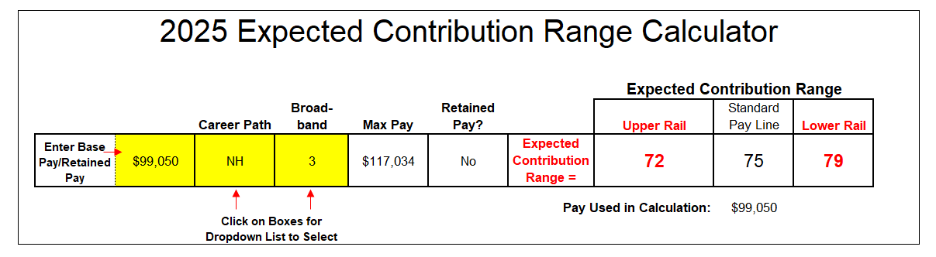

ECR Calculator
Basic Pay Only
Calculate an Expected Contribution Range (ECR) any time during the appraisal period using a calculator found at the AcqDemo website.
acqdemo.hci.mil/tools
Notes:
Employees may determine their Expected Overall Contribution Score (EOCS) and Expected Contribution Range (ECR) at any time by using the online ECR Calculator. The ECR Calculator provides the employee’s expected score in the Standard Pay Line (SPL) column, as well as the upper and lower ranges for appropriate contribution aligned with that basic pay.
The Expected Contribution Range Calculator can be found on-line at: http://acqdemo.hci.mil/tools

Slide 45
Expected Contribution Range (ECR)
$162,672
$140,000
Normal Pay Range
$120,000
$100,000
$99,050
$80,000
$60,000
$40,000
72
75
79
0
Overall Contribution Score
100
Contribution matches compensation if OCS is between 72 and 79
45
Notes:
We’ll use the Normal Pay Range to illustrate how one can receive an OCS within a specific range of scores and remain in the Normal Pay Range.
For this graph we’ve added the Normal Pay Range to the Standard Pay Line.
Same employee. We determined 75 to be the expected OCS based on this employee’s salary and the Standard Pay Line.
Using that same salary, we draw a line from the Y axis through the Normal Pay Range.
To form the limits of the expected contribution range, we draw lines from where the salary line crosses the upper and lower rails down to the x axis reflecting the OCS scores.
So, the Expected Contribution Range for an employee earning $97,392 is between 72 and 79

Slide 46
CRI Carryover
When a resulting CRI (increase in basic pay) exceeds a compensation maximum (broadband maximum, stop-and-consider OR control point), the pay pool panel MAY authorize a CRI carryover
Amount exceeding compensation maximum is added to the contribution award (CA)
Compensation maximum established by position management structure or broadband maximum
CRI
CA
Notes:
Federal Register notice, Section II.D.4.a., “Compensation Categories”
…Depending on the category into which an employee’s marker falls, he/she may be eligible for one to three forms of additional compensation. The pay pool panel has the option of awarding the employee up to and including the full General Pay Increase (as authorized by law or the President), a CRI (an increase in basic pay and/or a CRI carryover lump sum payment for the CRI basic pay amount that exceeds a control point in or the maximum basic pay of an employee’s broadband level) and/or a contribution award (a lump-sum payment that does not affect basic pay)

Slide 47
Time Off Awards
Time Off Awards
Employee may request that 25%, 50%, 75%, or 100% of their Contribution Award be converted to a Time-Off Award
Request made when submitting a self-assessment in CAS2Net
Notes:
Business Rule Decision – Will this be used, and if so how?
Federal Register notice, Section II.D.4.a., “Compensation Categories”
…Depending on the category into which an employee’s marker falls, he/she may be eligible for one to three forms of additional compensation. The pay pool panel has the option of awarding the employee up to and including the full General Pay Increase (as authorized by law or the President), a CRI (an increase in basic pay and/or a CRI carryover lump sum payment for the CRI basic pay amount that exceeds a control point in or the maximum basic pay of an employee’s broadband level) and/or a contribution award (a lump-sum payment that does not affect basic pay)

Slide 48
Pay Pool Payouts
Employee Name | Expected OCS | Approved OCS | Delta OCS | Current Basic Pay | CRI Target Pay | CRI Positive Delta Pay | Computed CRI | CA Target Pay | CA Positive Delta Pay | Computed CA
Contributor, Joe | 75 | 77 | 2 | $99,050 | $111,305 | $12,255 | $2,666 | $111,305 | $12,255 | $3,504
Sayers, Rose | 73 | 67 | -6 | $95,195 | $91,270 | ($3,925) | $0 | $91,270 | ($3,925) | $0
Collins, James | 73 | 73 | 0 | $95,195 | $102,811 | $7,616 | $1,657 | $102,811 | $7,616 | $2,177
Blaine, Rick | 66 | 68 | 2 | $82,849 | $93,100 | $10,251 | $2,230 | $93,100 | $10,251 | $2,931
Wayne, Bruce | 66 | 65 | -1 | $82,849 | $87,719 | $4,870 | $1,059 | $87,719 | $4,870 | $1,392
Munroe, Cora | 63 | 67 | 4 | $78,061 | $91,270 | $13,210 | $2,874 | $91,270 | $13,210 | $3,776
 |  |  |  |  |  | $48,201 | 21.7549% |  | $48,201 | 28.5888%
 |  |  |  |  |  |  | $10,486 |  |  | $13,780
All the CRI and CA Pay Pool dollars are distributed!!!
48

Slide 49
Deliberation Considerations
A zero delta OCS – employee is appropriately paid for his or her contribution. The employee is contributing as expected based on their current basic pay. It is not a determination that average work is being done.
A positive delta OCS - employee is being underpaid for his or her contributions. The employee contributes at a higher level than expected based on their current basic pay. Additionally, if the employee’s contribution level remains the same year-after-year, the delta OCS should decrease each year, as the expectations rise with the increase in salary.
A negative delta OCS - employee is being overpaid for his or her contributions. The employee contributes at a lower level than expected based on their current basic pay. It is not necessarily a determination that poor work is being done, unless the OCS is in the “A” overcompensated range.

Slide 50
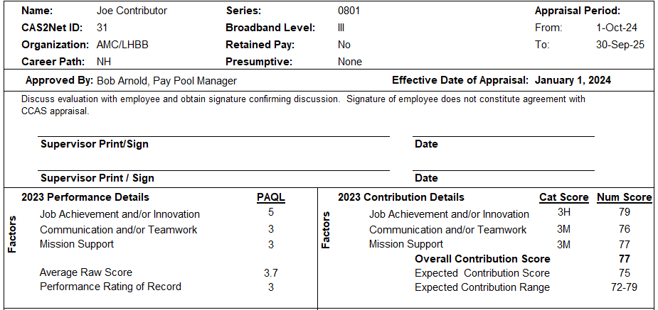
Annual Appraisal — Part I Form
Identifying
info
Signatures
Appraisal Details
Notes:
At the conclusion of the CCAS cycle once all pay pool decisions have been made final, an End-of-Cycle Discussion is held between each employee and their supervisor. The purpose is to discuss the employee’s appraisal, OCS, and the pay pool payout decision.

Slide 51
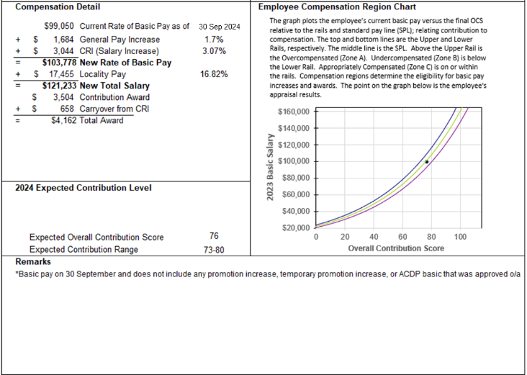
Annual Appraisal — Part I Form
Compensation
Detail
Remarks
Notes:
It should be a retrospective look at lessons learned and insights that can be carried forward into the current appraisal period to improve outcomes and organizational impact. It occurs in December or January, following the conclusion of the pay pool process.

Slide 52

Inadequate Contribution
Goal of System: Appropriate compensation for contribution to mission effectiveness
Contribution Improvement Plans (CIPs) must be considered when…
Contributions to mission accomplishment are inadequate
Inadequate contribution occurs…
When employee’s OCS plots in the Overcompensated Region
Unacceptable performance in any contribution factor
PAQL of 1 (Unacceptable) in any factor
Inadequate contribution could result in…
Reassignment
Reduction in Pay
Removal from Federal Service
Notes:
As we’ve discussed AcqDemo aims to go beyond a just performance-based rating system to link rewards to the levels of contribution. Therefore, the system also accounts for those whose contributions are judged to be less than appropriate for their compensation level.
Inadequate contribution occurs:
When the overall contribution score places the employee in the overcompensated region (above the rail)
An unacceptable performance appraisal level on at least one of the three contribution appraisal factors
Contributions in one or more of the Quality of Performance levels falls into the Unacceptable range
Inadequate contribution may be cause for reassigning employees, reducing their pay or removing them from Federal Service. This authority is similar to that for identifying poor performers under current Civil Service Rules.

Slide 53

CCAS Administrative Grievance Process
Employees may request reconsideration of:
Process:
Through a Collective Bargaining Agreement; or
Administrative Grievance Procedure (5 CFR 771) as supplemented by local procedures
Employee submits reconsideration to Supervisor
Supervisor provides recommendation to Pay Pool Panel
Pay Pool Panel may accept recommendation or reach independent decision
Pay pool decision is final unless employee requires reconsideration by next higher official to Pay Pool Manager
Next higher official renders final decision
OCS Rating
Quality of Performance Rating
Supervisor Assessment
Reconsideration requests must be submitted during the Open Window Period only
Notes:
An employee may request reconsideration of their OCS, Quality of Performance Rating, and Supervisor Assessment.
The process is either through a Collective Bargaining Agreement or an Administrative Grievance Procedure (5CFR 771) as supplemented by local procedures:
Employee submits reconsideration to Supervisor
Supervisor provides recommendation to Pay Pool Panel
Pay Pool Panel may accept recommendation or reach independent decision
Pay pool decision is final unless employee requires reconsideration by next higher official to Pay Pool Manager
Next higher official renders final decision
Check with your Component for specific request for reconsideration process timeline details.

Slide 54

Release of Aggregate Results
Pay Pool Manager will provide aggregate results of CCAS assessment process
After conclusion of CCAS Feedback period
Graphical representation of results
Pay pool scatter-plot, bar chart, etc.
Data tables displaying number and percentage of employees
By career path and
By rail region
Further delineation at the pay pool manager’s discretion
Data tables by career path and broadband
level to present…
Average OCS
Average CRI (dollars and percent of basic pay)
Average CA (dollars and percent of aggregate pay)
Average Rating of Record
Further delineation is at the Pay Pool Manager’s discretion

Slide 55




Slide 56
AcqDemo Pay Pool Panel Member Training
Notes:
Thank you for attending. Please let us know how we can best support your success in AcqDemo.

